Slide 1
HealthTech Landscape How emerging technology is impacting your practice
James Capps
Notes:
Tell you about me
I like to fix today’s problems
China Daily is an English-language daily newspaper owned by the Publicity Department of the Chinese Communist Party. Distributed to over 1.2B
1995 on-line
Satellite Newspaper

Slide 2
Agenda
1
Technology Trends
2
Trends Not Trending
3
Technology Practice Checklist for 2022
Notes:
Before we get started I want to talk about the three most difficult parts of your jobs.
After significant research and work,
The patients
The docs
Your staff
Dr. Michelle Sabick Dean of college of Engineering and Mathematics at DU

Slide 3
Technology Trends

Slide 4
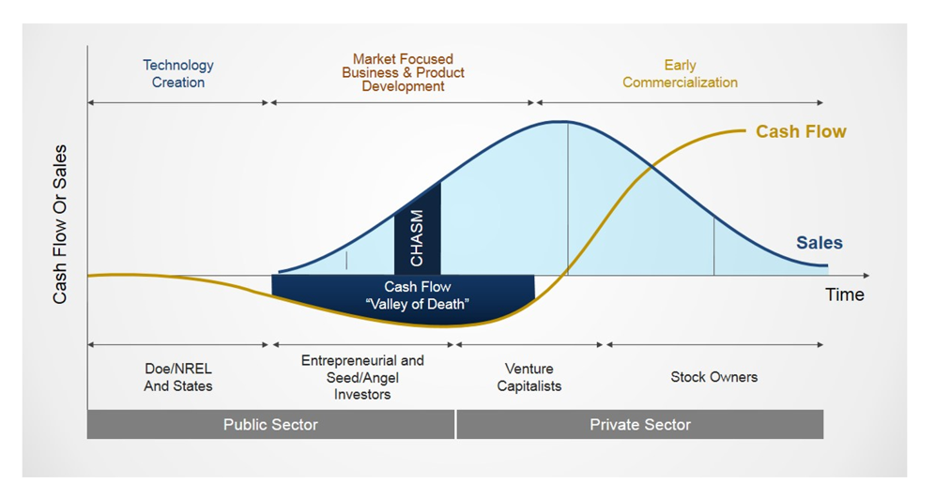
HealthTech ecosystem: Where are we?
Geoffrey Moore described innovation growth as “crossing the chasm” in his book of the same title in 1991. This view can be applied to a company as well as an ecosystem.
HealthTech has jumped the chasm
Many have died in Moore’s “Valley of Death”
Investments and acquisitions are driving sales
Cash flow is beginning to show
Notes:
While healthtech is centered around optimizing personal and preventative care, the medical technology—medtech—vertical focuses on therapeutic technologies and medical devices that treat existing medical issues and diagnostic technologies that detect medical conditions

Slide 5
Healthtech ecosystem: Where are we?
The lines between tech firms and healthcare companies are blurring, while the number of partnerships is growing rapidly. According to Deloitte’s analysis of Rock Health database:
88%
56%
82%
101%
56%
SMB practices have
incorporated
disruption into their core
strategy and are looking
for ways to invest in or
collaborate with technology
companies
82%
are expecting to increase
their partnerships over the
next few years. Technology
is a primary concern
Venture funding for health tech innovators, at US$14 billion, almost doubled in 2020 compared to 2019

Slide 6
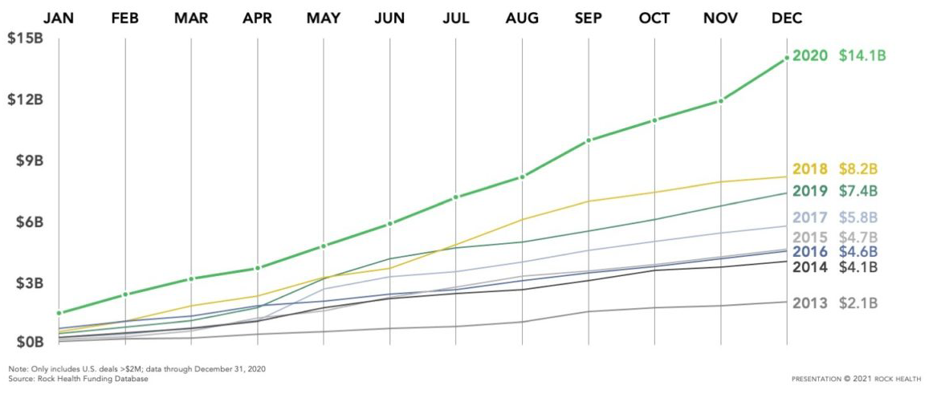
Digital Health Venture Funding

Slide 7
Emerging healthtech ecosystem: Where are we?
Many incumbent institutions are undergoing digital transformations to reimagine everything, from investing in core services and products to front-end and back-end processes.
For example, UnitedHealthcare Group launched its venture capital arm, Optum Ventures investing in 18 innovators in 2020 including:
Dispatch Health—A platform for on-demand acute care services from home
MindStrong Health—A neuropsychiatric disorders diagnosis and treatment platform
Truepill—An API-connected platform focused on pharmacy fulfillment and telehealth
“With it becoming easier to launch healthcare solutions, I expect to see the number of deals as well as total investment capital to set records.”
Matty Francis, Strategic Investing, Healthbox Investment Advisory

Slide 8
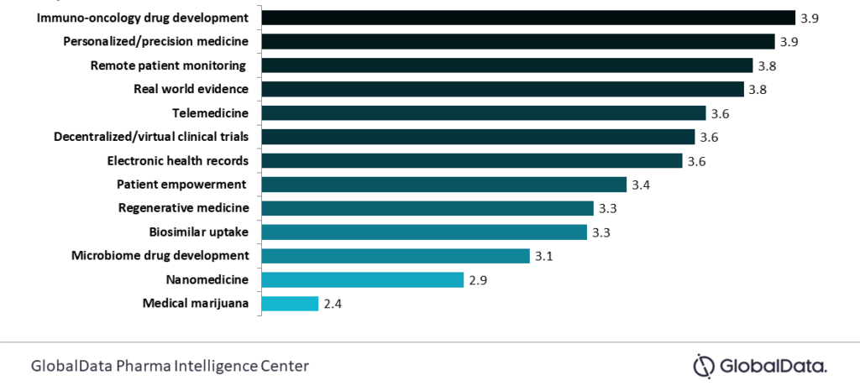
How do these trends affect you?
How are these technology trends impacting my staff and practice?
Source: 2019 Banking and Capital Markets Outlook: Reimagining transformation, Deloitte Center for Financial Services
Notes:
When surveyed, 5000 hospital professionals identified these items as top trends to watch
Med and healthtech
Biosimilar drugs are almost the same as brand names

Slide 9
Trends that are not all hype
Technology trends that will change the way you work

Slide 10
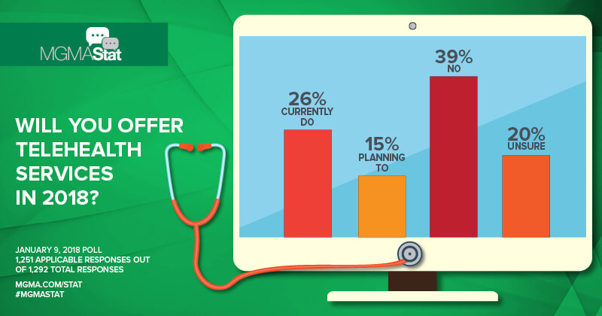
Telemedicine - MGMA Survey in 2018

Slide 11
Unstoppable development of telehealth
COVID has had predicable impacts to telemedicine numbers
Expected Outcomes:
30% of all visits during the pandemic were provided by telemedicine
66% consumers now willing to use telehealth
Unexpected Outcomes:
Telehealth doesn’t work for all care plans
Patient and Physician Experience (PX) has become equally critical
Massive need for mental health support and services
Everyone is now in IT
Notes:
Take away – We are far from fulfilling the full potential of telemedicine
One to two years ago, physician experience (PX) was almost considered a stand-alone category within digital health. Companies would even pitch themselves as patient or physician experience companies. Experience is closely linked to outcomes, so companies gaining traction are solving bigger health challenges and embedding experience into the core of their product, rather than selling experience alone. More bluntly, companies that don’t weave PX into the fabric of their platforms will likely struggle to win.

Slide 12
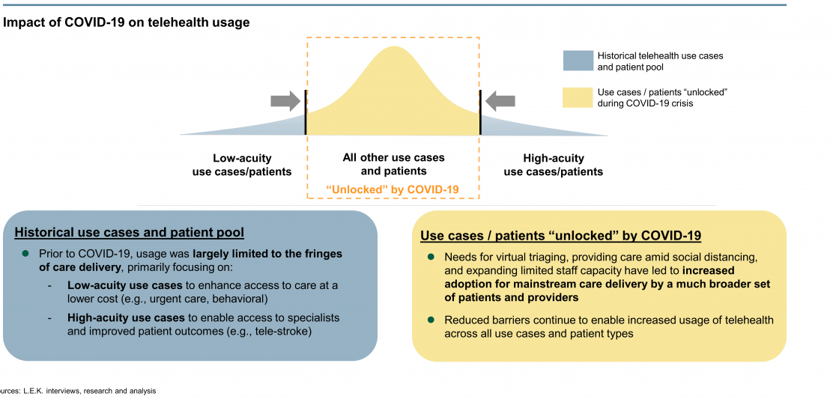
Covid drastically expanded addressable use cases and patients for telehealth
Source: FWIW, 2019

Slide 13
Remote Patient Monitoring (RPM)
68%
52%
88%
Practices who intent to use RPM
Patience who would use RPM if prescribed by a doctor
Healthcare systems who have invested in RPM
76% of patients enrolled in RPM see a significant decrease in readmittance within 90 days
RPM patient satisfaction is 91%
Notes:
Unlike other telehealth methods, RPM services do not require interactive video communication nor is it restricted to a certain area. All RPM requires is a mode of technology that aggregates and interprets physiological patient data. It additionally helps in improving the effectiveness of medical care and in the end decreasing expenses. It guarantees an expansion in accessibility and improves the estimation of care for both the patients and the healthcare providers.
Nearly 88% of healthcare organizations are investing or considering to invest in remote patient monitoring systems, and the good news is, t also continues to improve in healthcare 2021. According to Consumer Technology Association (CTA), 68% of healthcare organizations strongly like patient monitoring solutions.

Slide 14
Voice engagement
Voice engagement covers many functions.
Current ecosystem includes:
VoiceFriend is a simple yet powerful notification solution that enables you to easily keep seniors, staff and families informed of events and important information.
Tenor.ai is an automated medical scribe that listens to your patient visits via a small microphone in the exam room and creates an accurate patient note in real time.
WinterLight Labs has developed a novel AI technology that can quickly and accurately quantify speech and language patterns to help detect and monitor cognitive and mental diseases.
Patient-Provider Commas
Physician Notes
Speech & Hearing Difficulty
Patient Engagement
Vocal Biomarkers

Slide 15
Voice assistants
Users of voice assistants have already adopted using them in multiple functions
Source: 2019 Banking and Capital Markets Outlook: Reimagining transformation, Deloitte Center for Financial Services

Slide 16
Robotic process automation (RPA): AI finds a home
Artificial intelligence has long been discussed as a looming game changer, while it is argued that existing processes and systems hinder large-scale updates with built-in human inefficiencies.
RPA refers to robotic process automation software programs that automate repetitive human processes.
Utilizing the same application interface a human would, eliminating error and risk.
Robots cost around $15K annually per unit, with an initial implementation cost of $40K–$50K per robot.
Companies typically see 40–100% ROI within 3–8 months

Slide 17
RPA : The Automation Spectrum
Robotic Process
Automation
Intelligent
Automation
Cognitive
Intelligence
Artificial
Intelligence
Mimics
Human
Actions
Mimics Human
Judgment
Augments
Human Intelligence
Mimics
Human Intelligence
Used for rules-based, simple to complex processes
Faster handling time
Higher volumes
Reduced errors and costs
Used for judgement-based processes
Machine learning capability
Interprets human behavior
Used for predictable decision-making
Dynamically self-adaptable and self-managing
Acquires human like thought and decision-making capabilities
HAL 9000

Slide 18
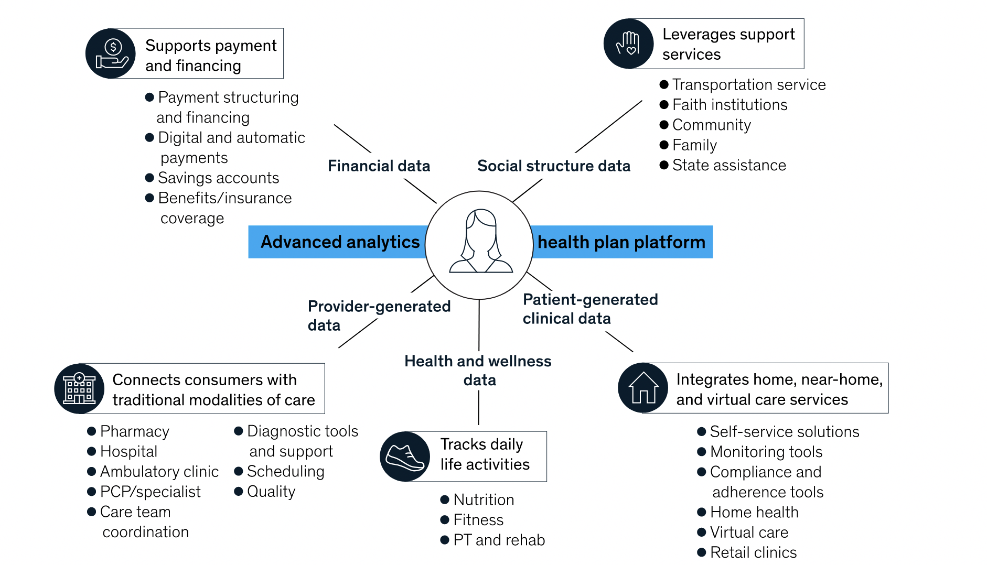
The Future of Health Care?
Healthcare ecosystems of the future will be centered on the patient
Notes:
I love this slide – explain how this is what we discussed
Love it because its wrong
Centered on the patient. Patients are idiots.

Slide 19
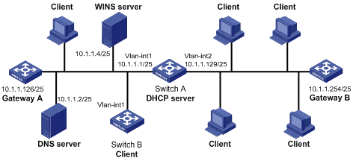
The Real Future of Health Care
Notes:
This is healthcare of the future

Slide 20
Not in 2022

Slide 21
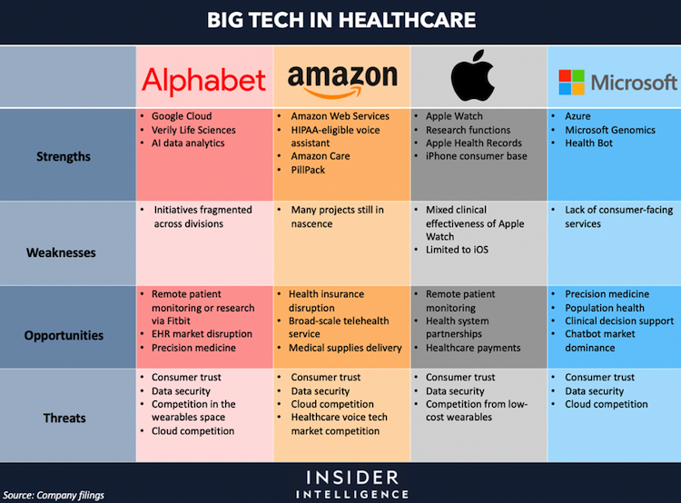
Big tech vs. big healthcare
Source: Company filings

Slide 22
Blockchain and distributed ledger simplified
DL is a decentralized network that enables exchange of information between peers without third-parties.
Each transaction/interaction is transparently recorded and forms a chain of history that cannot be altered in the future.

Slide 23
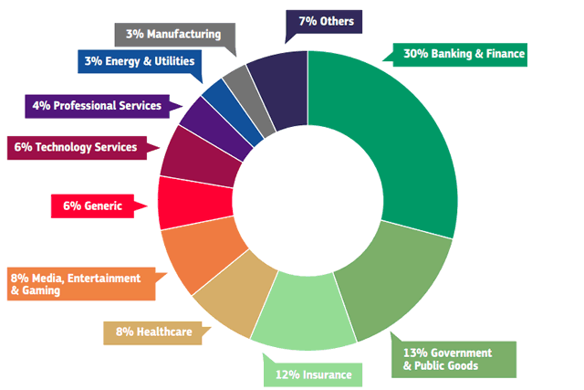
Blockchain and distributed ledger users
Recent studies have highlighted areas where the most value will be realized by applying this technology.
Source: European blockchain observatory and forum April 2019 based on self-declarations by 400 startups and other blockchain initiatives
Notes:
Current research on implementations of blockchain technology in healthcare that go beyond the state of concept studies or theoretical implementation ideas was explored in this mini review. Also, major publications were examined in detail and categorized into three different main use cases of blockchain implementations in healthcare. The study shows, that secure storage and access to medical data are becoming increasingly important. The development of a secure, reliable and digital solution for this need is increasingly linked to the principles of blockchain technology. It is shown that hybrid solutions based on conventional data storage and secure, blockchain-based access control are more effective and economical than complete data storage in a blockchain. In addition, automated blockchain solutions based on smart contracts are recommended, e.g., when tracking medical supply chains.
In the future, specific guidelines for the electronic storage of patient data, medical products, devices and materials used etc. should be developed, which are important for patients and indispensable for any further treatment. Then the information should be defined that can be encrypted but stored publicly via permissionless blockchains as well as the information that is encrypted and in addition may only be accessible to authorized network participants in permissioned blockchains. With this, the storage of larger amounts of data must also be considered. Further studies with decentralized off-chain storage systems such as IPFS are conceivable for that as well as studies with ML methods for extracting and storing only relevant information from large amounts of data. The securing of the anonymity of the patient data to be stored de-centrally, the legal framework and the protection against data theft by criminal parties must also be considered. By then, at the latest, prototypical applications must increasingly be developed and established that go beyond early stage implementations.

Slide 24
Your Practice in 2022

Slide 25
Update your information technology operating model
Your operating model is beginning to look quite stale, even if it is serving you well today. External factors are influencing your customer’s expectations.
Systems
Cyber Security
Processes
Data
Governance

Slide 26
Slash costs by simplifying legacy systems
Now is the time to take software as a service (SaaS) to the next level. Broader cloud adoption and investment in robotics and AI are critical cost saving strategies to consider.
60%
70%
80%
less invested in capital equipment by Emerging Technology vs. traditional companies
of large offices and hospitals are investing in systems to drive costs down
Fixed assets are at end-of-life at most offices
Source: 2019 Banking and Capital Markets Outlook: Reimagining transformation, Deloitte Center for Financial Services
Notes:
One of the starkest differences between a legacy financial services institution and a Emerging Technology upstart comes down to fixed assets. Incumbents carry a huge burden of IT operating costs, stemming from layer upon layer of systems and code. They have bolted on a range of one-time regulatory fixes, fraud prevention, and cyber-security efforts, too. The ever-spreading cost base leaves less budget available for capital investment into new technology, driving a vicious cycle of increased operating costs. This is in clear contrast to the would-be disruptors, who typically have far lower operating costs, only buying what they need when they need it.
It doesn’t have to be that way. In fact, from our experience working with a wide variety of clients in banking and capital markets, insurance, and asset management, we think many financial institutions are spending up to twice as much as they need to on IT.
3.

Slide 27
Use tech to understand your customers’ needs
How your practice manages office hours and after-hours support will need to evolve.
Prepare for an always-on practice
Auto insurance can now be bought by the mile or by the hour
Merchants on Alibaba can get micro-loans within minutes to finance working capital for only a few hours
Rocket Mortgage can offer initial mortgage loan decisions in as little as eight minutes
BNP Paribas’ neo-bank, Nickel, opens a new account every 30 seconds
Clients’ situations change quickly
Large opportunity for providers to be available when those changes happen
Respond pro-actively when they do

Slide 28
Prepare to connect to anything, anywhere
Your business can no longer operate only within your four walls. You need to enable external connections to leverage the information available to you and your competitors.
Key endpoints that will need to coexist and cooperate:
Enterprise databases
Data warehouses
New and existing applications
Legacy systems
Third party “big data” sources
Cloud services to leverage:
Business-to-business (B2B) connections, linking to comparable systems at partners and suppliers
Business-to-consumer (B2C) connections, linking to apps, wearables, and mobile devices at an individual user level
Bring-your-own-device (BYOD) connections, using an enterprise mobility strategy to link to employees and contractors
Notes:
The systems are diverse, and they are getting more complex by the week. Now, financial institutions will need to layer on a more sophisticated view of federated identity management, because companies will be dealing with new classes of users. Systems architecture can be the key to balancing control and accessibility. That is, the way you assemble the technical building blocks can protect your institution against cyber-threats without adding needless barriers to discourage interaction.

Slide 29
Necessary talent and skills to execute and win
Try “this is what we will offer” rather than “what do our customers want?”
Existing team members may not be ready for the challenges of tomorrow.
Needs of clients include new tools, new applications
Experience with social media is no longer enough
Identifying key partners who can help evolve IT solutions is key.
Short-term approach using external resources to train your staff
Longer-term approach to leverage experts to keep pace with technology
Technology skills now include computers, cloud, communications, security, and vendor management.
Notes:
Leveraging your grandkids is not a business plan

Slide 30
You can’t pay enough attention to cybersecurity
Growing number of cybersecurity events in recent years has shown that the traditional approach is no longer good enough.
Historical approach:
Enterprise databases
Controls-based
Compliance-based
Perimeter-oriented
Aimed at securing data and the back office
New approach:
Client training
Pro-active testing
When (not-if) plans
Vendor diligence
Real-time monitoring and alerting

Slide 31
Conclusion

Slide 32
An accelerated technology-heavy ecosystem
The trends toward a technology-heavy ecosystem continue to accelerate. An active approach towards maintaining currency is required.
Consider a shift towards increased automation, mobility, and digitization.
Blockchain, machine learning, AI, and robotics are making huge waves
Competition is getting tougher and investors are becoming overly selective.
Most established organizations feel this pressure
Resulting in an increased number of partnerships and market acquisitions
Now is the time to drive our industry to a more customer-centric state.
Successful providers respond to the constantly changing demands and needs of their customers
Notes:
The trending shift towards increased automation, mobility and digitization in financial services continues. Blockchain, machine learning, AI, and robotics, are making huge waves in Emerging Technology, bringing both synergy and disruption to the industry.
The competition is getting tougher while investors are becoming overly selective. Even the world's most established financial institutions feel this pressure which leads to an increasing number of partnerships and market acquisitions.
As Emerging Technology companies are becoming more mature and technology-oriented, they face the need to invest more into elaborate software backed by advanced analytics and personalized marketing campaigns. This leads Emerging Technology to a more customer-centric state where providers are driven by constantly changing demands and needs of their customers.

Slide 33
Q&A

