Slide 1
Developing an Inspired Leader:
How to Get People Out of Their Cave and Into the Sun
Colorado MGMA Fall Conference
Aimee Greeter, MPH, FACHE, Senior Vice President
September 23, 2021

Slide 2
AGENDA
Conscious Competence Ladder: What Is It?
Leadership Development: But How Do We Do That?
Conscious Competence Ladder and Healthcare: Why Does it Matter?
Conclusions and Q&A: What Happens Next?

Slide 3
“I’m not telling you it’s going to be easy –
I’m telling you it’s going to be worth it.”
-Art Williams

Slide 4
CONSCIOUS COMPETENCE LADDER:
WHAT IS IT?

Slide 5
CONSCIOUS COMPETENCE LADDER
Originally developed by Noel Burch in the 1970s at Gordon Training International and titled the “four stages for learning any new skill”
Four stages correlate to levels of awareness of incompetence relative to a specific skill
The end result is a person being able to perform a skill with little to no thought
This is often used to train employees and hone a new skill set, walking people through improving themselves in any area

Slide 6
CONSCIOUS COMPETENCE LADDER: IGNORANCE
Unconscious Incompetence
Individual does not understand or know how to do something and does not necessarily recognize the deficit
Individual must accept own incompetence before moving to the next stage
1
Most start here

Slide 7
CONSCIOUS COMPETENCE LADDER: AWARENESS
Conscious Incompetence
Though the individual does not understand or know how to do something, he or she recognizes the deficit and value of learning the new skill
The making of mistakes can be integral to the learning process at this stage
2

Slide 8
CONSCIOUS COMPETENCE LADDER: LEARNING
Conscious Competence
Individual understands or knows how to do something; however, demonstrating the skill requires concentration
The skill may be broken into steps, and there is heavy conscious involvement in executing the skill
4
3

Slide 9
CONSCIOUS COMPETENCE LADDER: MASTERY
Unconscious Competence
Individual has had so much practice with a skill that it becomes “second nature”
As a result, the skill can be performed while executing another task
The individual can typically teach skill to others
4

Slide 10
CONSCIOUS COMPETENCE LADDER: EXAMPLE
Physician creates standard within service line, works with other service lines to implement similar processes.
4
Physician works with her peers to develop best practices for common cases, identifying areas of improvement in her own work.
3
Physician is made aware of alternatives in the form of best practice guidelines and reviews cases/examples where these are utilized – both within her organization and across the country.
2
Physician is performing clinical work in a relatively undefined manner, noting that this is the “historical” and “standard” way she performs a procedure. No consideration is given to data-driven best practices or establishment of internal care guidelines.
1

Slide 11
PAIR/SHARE EXERCISE #1
Share with your neighbor one of the core responsibilities of your role, and where you land on the Conscious Competence Ladder with respect to that responsibility
As a reminder:
Unconscious Competence
4
Conscious Competence
3
Conscious Incompetence
2
Unconscious Incompetence
1
1

Slide 12
COMMON MISPERCEPTIONS
Action-Based vs Knowledge-Based
Level 4 is Finite
External Impetus
Timeline for Completion
Notes:
1. Action-Based vs Knowledge-Based

Slide 13
OTHER MODELS OF SKILL DEVELOPMENT
RIME model
Reporter
Interpreter
Manager
Educator
Dreyfus model
Novice
Advanced beginner
Competent
Proficient
Expert
Hersey-Blanchard Situational Leadership model
Enthusiastic beginner
Disillusioned learner
Capable, but cautious, contributor
Self-reliant achiever

Slide 14
LEADERSHIP DEVELOPMENT:
BUT HOW DO WE DO THAT?

Slide 15
BUILDING LEADERS
Organizations should work to identify exceptional leaders in their organization to begin building other leaders, creating an ongoing system of development
This should be a formal program that seeks to further the impact of leaders throughout the organization
The end goal should be to have successful, results-driven individuals (both clinicians and non-clinicians) leading initiatives throughout the organization
This will not only improve overall results within the organization (quality, cost, patient satisfaction, etc.), but it will also increase morale and buy-in to the organization

Slide 16
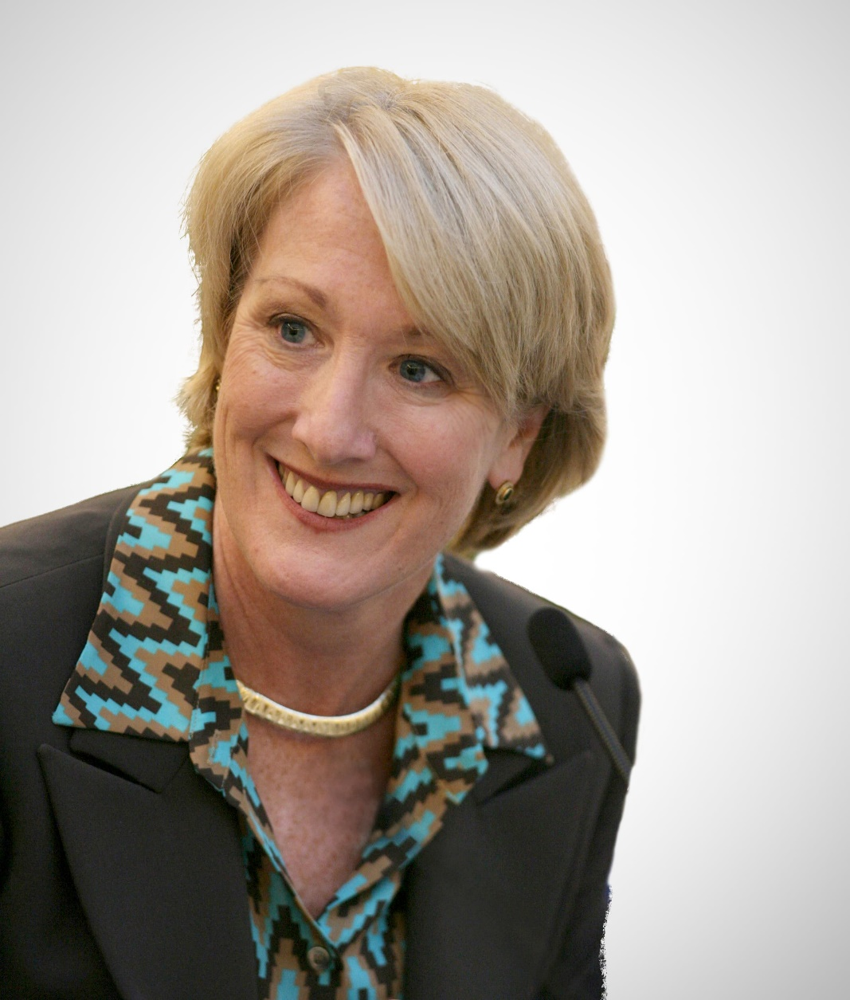
BUILDING LEADERS: IGNORANCE
Source: https://www.cnbc.com/anne-mulcahy/

Slide 17
BUILDING LEADERS: IGNORANCE
Identify Prospective Leaders
STEP 1
Identify potential leaders and begin evaluating leadership styles and determining areas of improvement.

Slide 18
BUILDING LEADERS: AWARENESS
Source: https://www.youtube.com/watch?v=XLF90uwII1k

Slide 19
BUILDING LEADERS: AWARENESS
Develop Formal Training Process
STEP 2
Incorporate clinicians/non-clinicians into formal training process, including a feedback loop, mentorship program, and peer review functions

Slide 20
BUILDING LEADERS: LEARNING
Source: https://en.wikipedia.org/wiki/The_Ritz-Carlton_Hotel_Company

Slide 21
BUILDING LEADERS: LEARNING
Empower Individuals as Leaders
STEP 3
Establish leadership roles and empower them with actual decision-making abilities
Develop and implement a dyad/triad leadership structure to improve transparency and trust

Slide 22
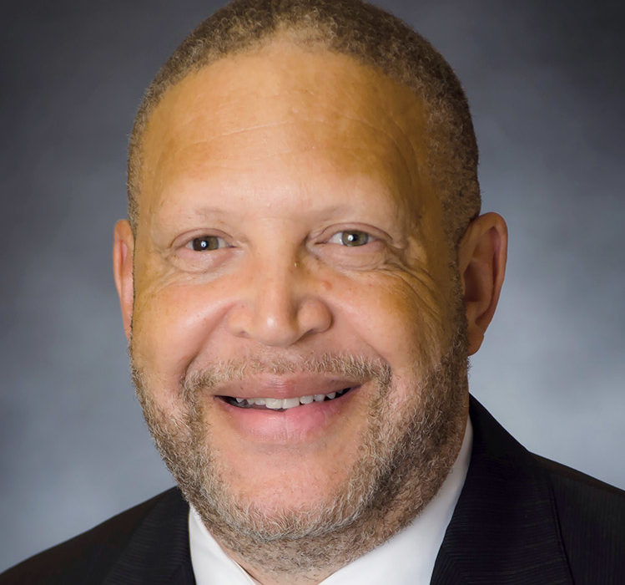
BUILDING LEADERS: MASTERY

Slide 23
BUILDING LEADERS: MASTERY
Develop Succession
Plan
STEP 4
Work with newly established leaders to identify new wave of potential leaders; repeat process

Slide 24
PAIR/SHARE EXERCISE #2
With your neighbor, discuss how you can take the first step in:
Identifying prospective leaders
Developing formal training processes
Empowering individuals as leaders
Developing succession plan

Slide 25
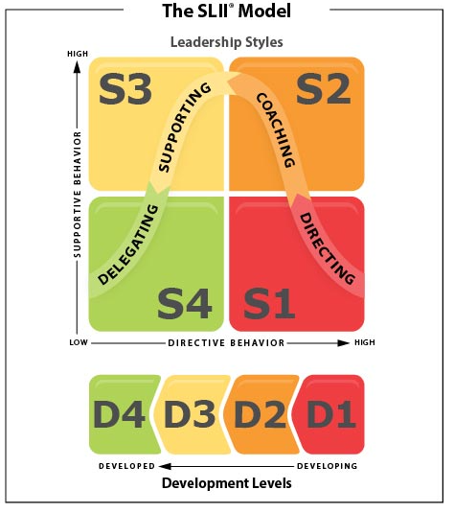
REVISITING OTHER MODELS OF SKILL DEVELOPMENT
Hersey-Blanchard Situational Leadership model has two applications:
Diagnosis of developmental level
D1 – Enthusiastic Beginner
D2 – Disillusioned Learner
D3 – Capable, but Cautious, Contributor
D4 – Self-Reliant Achiever
Determination of appropriate leadership style
S1 – Directing
S2 – Coaching
S3 – Supporting
S4 – Delegating
Source: https://www.kenblanchard.com/Products-Services/SLII

Slide 26
CONSCIOUS COMPETENCE LADDER:
WHY DOES IT MATTER?

Slide 27
WHY DO WE NEED ENGAGED LEADERSHIP?
Quality and cost initiatives
Accountability for performance
Organization imperative
Value-based care requirements

Slide 28
REALITIES OF HUMAN CAPITAL IN HEALTHCARE
58%
58% of Organizations Struggle to Find Talent
54%
91%
54% of CEOs are Physicians
13%
Women Comprise 13% of Hospital CEOs
91% of Hospital CEOs are White
Sources: Healthcare Dive; NCBI; ACHE; Healthcare Finance

Slide 29
PAIR/SHARE EXERCISE #3
With your neighbor, discuss:
How will you use your skills for the collective good?
How will you encourage others to do the same?

Slide 30
CONCLUSIONS AND Q&A:
WHAT HAPPENS NEXT?

Slide 31
CONCLUSIONS
Rise of value-based care has placed a spotlight on the need for stronger physician leaders for healthcare organizations to remain competitive.
Successful and effective physician leadership requires investment of time and resources from their strategic partner(s).
Significant opportunity is available for organizations if they establish physician leaders to work on increasing financial performance, improving quality of care, and lowering costs.
A key outcome of increased physician leadership is the ability to more successfully participate in value-based reimbursement structures.
Healthcare organizations should actively support these initiatives but empower physicians to be true leaders and drive change at the front lines.
Shared vision, objectives and mindset with the supporting infrastructure of a hospital/health system will result in higher value for all stakeholders.

Slide 32
“One person can make a difference,
and everyone should try.”
-John Fitzgerald Kennedy

Slide 33
Q&A

Slide 34
CONNECT WITH COKER GROUP
Keep current with what’s happening with Coker with our weekly email blast. Our consultants explore topics currently trending in the healthcare marketplace.
Our monthly newsletter is delivered straight to your inbox, providing thoughtful insights, Coker’s latest healthcare executive search, our latest white papers, and more.
Our podcast educates healthcare executives and professionals on business practices and industry trends, and includes conversations with our skilled consultants as well as seasoned industry experts from across the country.
Get expert tips and thoughtful takeaways everyday by following us on Twitter, LinkedIn and Instagram
TO LEARN MORE ABOUT COKER GROUP AND SIGN UP FOR OUR MAILING LIST, PLEASE VISIT US AT COKERGROUP.COM

Slide 35
OUR OTHER OFFICE LOCATIONS
216 Centerview Drive, Suite 230
Brentwood, Tennessee 37027
436 East 36th Street
Charlotte, North Carolina 28205
AIMEE GREETER, MPH, FACHE
agreeter@cokergroup.com
2400 Lakeview Parkway, Suite 400
Alpharetta, Georgia 30009
800.345.5829
www.cokergroup.com

