Slide 1
Effective Listening and
Personal Branding

Slide 2
Best Listener
Who is the best listener you know personally?
What makes you believe they are such a powerful listener?

Slide 3
Levels of listening
Ignoring
Pretending
Selective
Attentive
Active

Slide 4
LISTENING BASICS
Be interested
Observe non-verbal behaviors
Avoid interrupting
Use both open and closed questions
Reflect
Remain open-minded
Notes:
In your formal education – kindergarten, elementary school, middle school, high school, college, online, CPE, etc…

Slide 5
Be INTERESTED
Cultivate a “Genuine Desire to Listen”
Lean forward
Smile
Make eye contact (without being creepy)
Check your angry resting face

Slide 6
OBSERVE NONVERBAL BEHAVIOR
Clenched jaw or fist
Fidgeting
Arms crossed
Avoiding eye contact
Sweating

Slide 7
AVOID INTERRUPTING
STOP TALKING
FOCUS on the SPEAKER
LISTEN HARDER

Slide 8
AVOID JUDGMENT
Remain open
Avoid making conclusions
Avoid judgment
Be aware of bias

Slide 9
USE OF QUESTIONS:
Open-ended : could, what, why, how and would
Closed-ended did, are and is.

Slide 10
REFLECT
Use encouraging words or sounds (uh huh, yeah)
Nodding
Mirror body language (when appropriate)
Notes:
In your formal education – kindergarten, elementary school, middle school, high school, college, online, CPE, etc…

Slide 11
Hardest homework of your life
For the next five days,
Take one hour per evening and ban ALL electronics
Focus on someone for an hour – cultivate a genuine desire to listen
Write down at least one new thing you learn each day
Read what is being said and what isn’t being said
Report back

Slide 12
Manage Yourself
Notes:
Physics example and “pushing people”

Slide 13
Rights Responsibilities
Increase
Decrease
Owners
Managers
Employees
Increase
Decrease
MANAGE YOURSELF

Slide 14
Control the things you can control
Your actions
Your results
Your brand
Lead the things you can’t control
Others actions
Others results
Engage in the things that need to be controlled
Feedback
Team selection
MANAGE YOURSELF

Slide 15
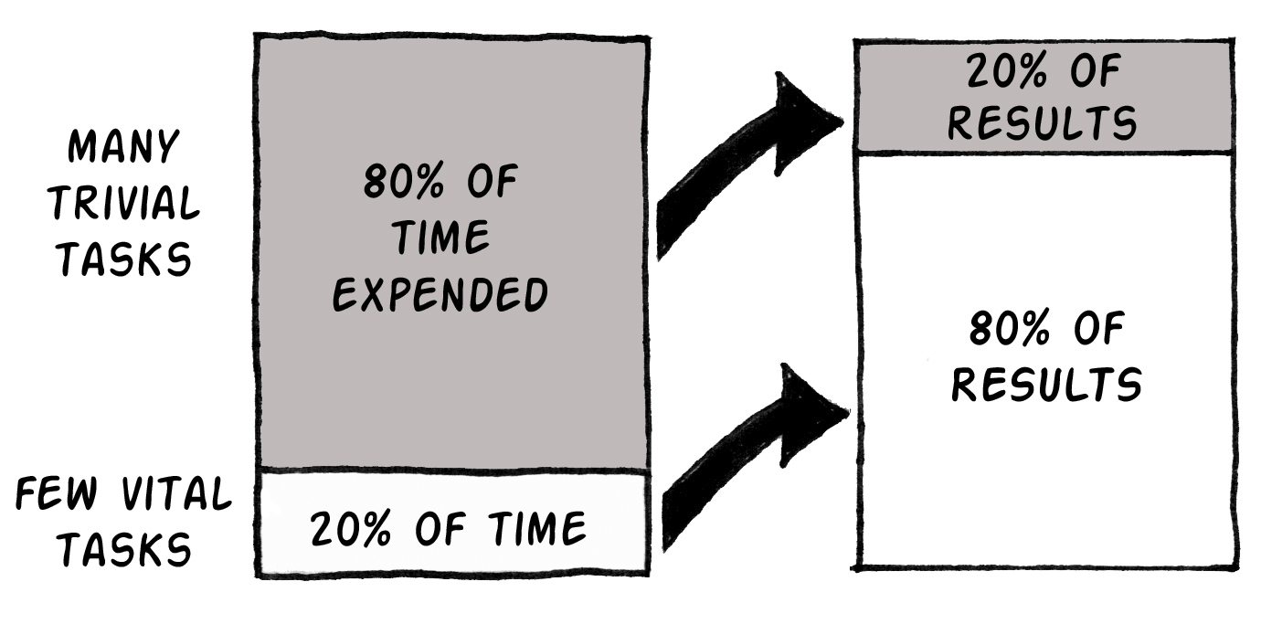
80/20 Rule-MANAGE TIME
MANAGE YOURSELF
Notes:
Introduce the 80:20 rule- another powerful yet often overlooked time-savers time-maker! and productivity enhancers.
80% of unfocused effort generates only 20% of results
Remaining 80% of results are achieved with only 20% of your efforts
GOAL: find the 20% that generate the 80% of results
Why is it over-looked? As humans, we are hardwired to believe our results are equal to our efforts. Even when we understand this rule, we often fail to translate it into the changes in the way we behave. It is very easy to recognize when someone else is wasting our time, it is not so easy to see it in ourselves.
80% of your results come from 20% of your efforts.
So, if your PRIMETIME is 20% of your day or week, and it is on lockdown, you will receive 80% of results

Slide 16
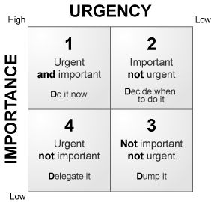
Quadrants of time
Important
Urgent
Important
Not Urgent
Not Important
Urgent
Not Important
Not Urgent
MANAGE YOURSELF

Slide 17
“If The Big Rocks Don’t go in First, They Aren’t going to Fit in later.” -Stephen R. Covey
Notes:
Physics example and “pushing people”

Slide 18
Preparing to Delegate
Only I MUST do
Others can help do
Others should do
MANAGE YOURSELF
Notes:
Should denotes a choice! These are the things that you need to choose to do. People get hung up on “things only I CAN do” because they think they are the only person with the ability to do. But, these are the things that you can train others, with the ability, to do. You have to be really careful NOT to over-estimate your abilities and under-estimate the abilities of others. You may have more experience and can do it faster but it is an area for you to train others in.
DELEGATING IS A PROFESSION NECESSITY!

Slide 19
MANAGE YOURSELF
Notes:
Should denotes a choice! These are the things that you need to choose to do. People get hung up on “things only I CAN do” because they think they are the only person with the ability to do. But, these are the things that you can train others, with the ability, to do. You have to be really careful NOT to over-estimate your abilities and under-estimate the abilities of others. You may have more experience and can do it faster but it is an area for you to train others in.
DELEGATING IS A PROFESSION NECESSITY!

Slide 20
What is your brand?
Consistently Dependable
Keep your knowledge strong
Bring it with Enthusiasm
Do more than expected
Serve
MANAGE YOURSELF

Slide 21
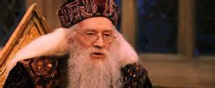
Why courage is a must
“It takes a great deal of bravery to stand up to our enemies, but a great deal more, to stand up to our friends. I award ten points to Neville Longbottom.”
Albus Dumbledore

Slide 22
D. MADDOX CASEY, CPA
Member
2500 Acton Road | Birmingham, AL 35243
D 205.769.3392
Maddox.Casey@warrenaverett.com
Maddox Casey is a Member of Warren Averett and the practice leader for the Firm’s healthcare division.
His team serves over 650 physician clients across the Southeast. Maddox helps physicians increase and maintain profitability in the turbulent times of healthcare regulations. He is a firm believer that through proper planning and education of current policies, he can help his clients thrive. Maddox is a frequent speaker for medical organizations across the country. He resides in Birmingham with his wife and five children.
Professional Affiliations
American Institute of Certified Public Accountants
Alabama Society of Certified Public Accountants
Local and State Medical Group Management Association
Birmingham Business Journal’s Top 40 Under 40, 2015
Vistage Group 9254

