Slide 1
Artificial Intelligence (AI) & Machine Learning (ML): Challenges and Opportunities for Health Care
Kent Bottles, MD
Colorado MGMA Conference, September 13, 2019

Slide 2
The Four Industrial Revolutions
First (1760 to 1840): the steam engine
Second (1870 to 1914): the telegraph, the telephone, the light bulb; industries powered by steam & electricity
Third (1969 to 2000): New information and communication technology (Internet) converge with renewable electricity to digitize global manufacturing
Fourth (2000 to future): Artificial Intelligence, Big Data, and Machine Learning are general purpose technologies like steam engine and electricity

Slide 3
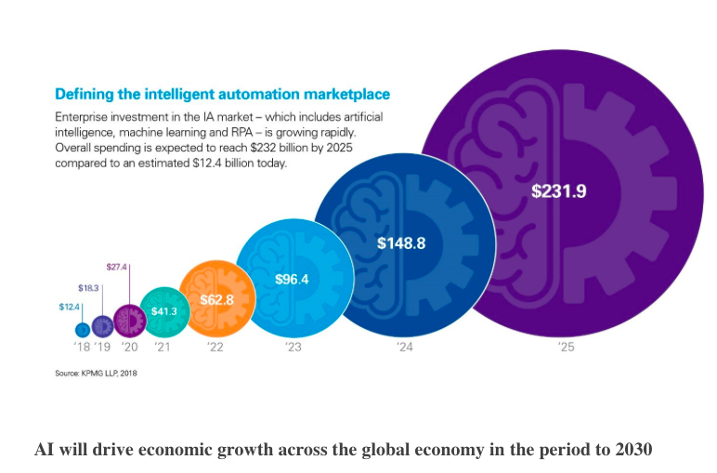

Slide 4
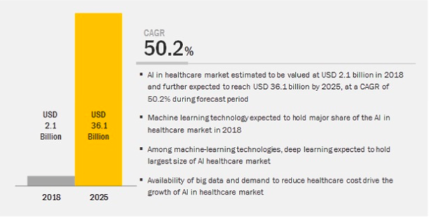

Slide 5
Technologies That Will Transform Health Care
Artificial Intelligence
Machine Learning
Predictive Analytics
Precision Medicine
Cloud Computing

Slide 6
High Performance Medicine
Eric Topol, Nature Medicine, Jan 2019
Medicine is at crossroad of major trends
Disruption of a failed business model
Generation of data from imaging, biosensors, genome sequencing, and electronic medical records that exceeds ability of human analysis and requires machine learning.
Cloud Computing
Ability to preform predictive analytics on huge amounts of data
Predict and Prevent Precision Medicine

Slide 7
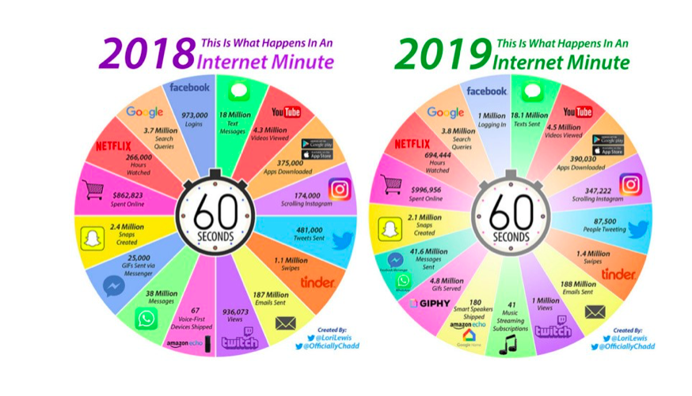

Slide 8
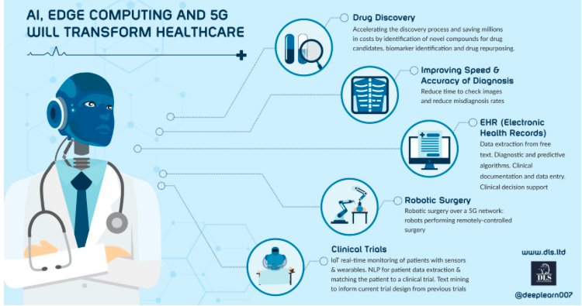

Slide 9
AI Will Affect All of Health Care
Drug discovery
Robotic surgery
Personalized medicine
Managing medical records and other data
Health monitoring via wearable trackers
Medication management
Healthcare system analysis
Workflow and administrative tasks

Slide 10
AI & Pharma
Batting average of turning compound into medicine is 0.100
Price tag of developing new drug $2.6 billion
Mature data sets: curating safety reports
Drug design: identify targets (receptor on cells); identify compounds bind to target; identify compounds that can travel to target in the body
Biological understanding

Slide 11
Berg
Id unknown cancer mechanisms in over 1000 cancer
Vary level of sugar and oxygen cells exposed to
Track lipids, metabolites, enzymes, protein profiles
Discovered how new drug BPM31510 works on pancreatic cancer cells

Slide 12
Verb Surgery
Google J&J joint venture
All surgical robots are connected via Internet
Record data from each procedure and apply ML to learn best surgical practices
Called Surgery 4.0 with integration of virtual reality and 3-D video microscopy
ML draws upon intraoperative imaging as well as relevant patient clinical data will redefine past practice and improve outcomes

Slide 13
Workflow & Administrative Tasks
Accenture estimates could save $18 billion a year
Save time on routine tasks
Johns Hopkins and GE AI for scheduling bed assignments and managing requests for unit assistance
Nuance cut documentation time and improve report quality by Computer assisted physician documentation

Slide 14
Hospitals & Health Systems
Detect patterns & normalize data
To map care pathways and processes
Reduce costs in care
Improve outcomes
MACRA & MIPS have bonus payments and decreased payments based on quality and efficiency of care delivered by individual physicians

Slide 15
Stat News
Casey Ross, May 13, 2019
Cleveland Clinic, Yale New Haven, Johns Hopkins
Central Monitoring Units
77,000 phone calls to nurses in one month
Alert nurses to cardiac emergency about to occur
Machine learning utilized to spot emerging emergencies

Slide 16
Health Care Applications of AI
https://www.ncbi.nlm.nih.gov/pmc/articles/PMC5568844/
Kaiser Permanente Medical Group studied 650,000 hospitalized patients, 20,000 required ICU care
20,000 in ICU are four times more likely to die than if deterioration was prevented in first place
Created predictive analytic model to identify which patients today are most likely to end up in ICU tomorrow
Monitor health status of all patients and alert physicians via automated early warning system to patients who are at risk of needing ICU care

Slide 17
Definitions
Artificial Intelligence (AI): the mimicking of human cognition by computers that can reason, discover meaning, generalize, and learn from experience
Machine Learning (ML): Algorithms sift through vast numbers of variables looking for patterns that predict outcomes by combining them in nonlinear and highly interactive ways without explicit programming. Computer learns from data over time and allows us to use large amounts of new kinds of more complex data.
Supervised learning: Goal of predicting a known output or target. Automated EKG interpretation; automated detection of lung nodule on CT scan.
Unsupervised learning: No outputs to predict. Finding naturally occurring patterns or groupings within the data. Redefine disease according to pathophysiologic mechanisms. Eosinophilic subtype of asthma which responds to therapy targeting eosinophil secreted cytokine IL-13.
Deep learning: Uses a cascade of multiple layers of nonlinear processing units for pattern recognition. Each successive layer uses output from previous layer as input for analysis.

Slide 18
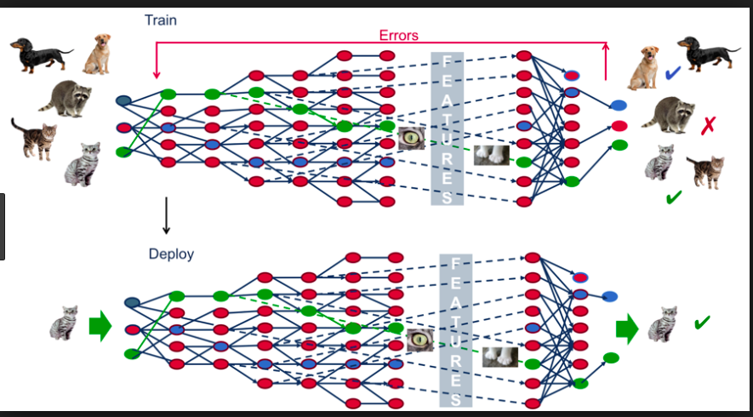

Slide 19
Definitions
Algorithm: Set of rules that precisely defines a sequence of operations that lead to a goal or output
Artificial neural network (ANN): Computing systems inspired by human brain that perform tasks by looking for patterns without being programed with task specific rules. ANN learn from data.
Natural language processing (NLP): Computer being able to process and analyze large amounts of human language data for syntax, semantics, discourse, and speech recognition
Computer vision (CV): Interdisciplinary field studies how computers can acquire, process, and analyze digital images to extract high dimensional data from pictures and videos.

Slide 20
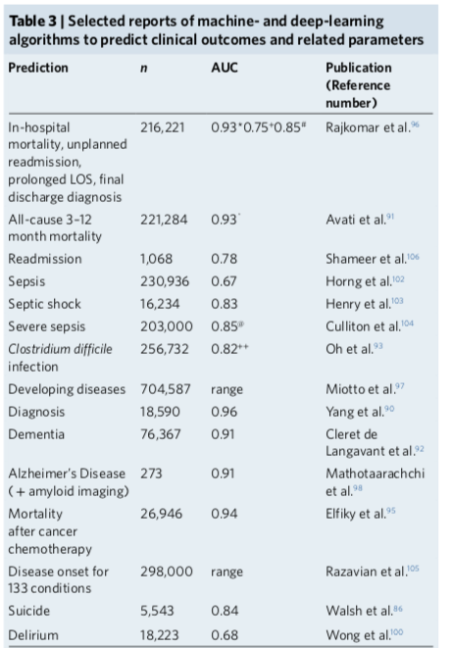

Slide 21
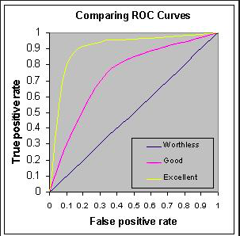

Slide 22
AI Equals or Outperforms Physician
Cardiologist-level arrhythmia detection with convolutional neural networks. arXiv preprint arXiv: 1707.01836
Development & validation of a deep learning algorithm for detection of diabetic retinopathy in retinal fundal photographs. JAMA 316, 2402-2410. 10.1001/jama. 2016. 17216 [PubMed]
Diagnostic assessment of deep learning algorithms for detection of lymph node metastases in women with breast cancer. JAMA 318, 2199-2210. 10.1001/jama 2017.14585 [PubMed]
Dermatologist-level classification of skin cancer with deep neural networks. Nature 542: 115. 10.1038/nature21056 [PubMed]
Predicting non-small cell lung cancer prognosis by fully automated microscopic pathology image features. Nat Commun. 2016; 7(7): 12474.

Slide 23
Google DeepMind AI Diagnoses Eye Diseases
Jeffrey De Fauw, et. al. Nature Medicine, 13 August, 2018
94% of patient optical CT scans at Moorsfield Eye Hospital were correctly diagnosed based on AI
Identified portions of optical coherence tomography scans used to make AI diagnosis
AI identified 50 different eye diseases
Across all cases AI error rate 5.5% vs top two human specialists (6.7% & 6.8%)

Slide 24
Radiology
2 billion CXR performed worldwide
AI outperformed 4 radiologists in detecting pneumonia over 112,000 CXR with AUC of 0.76
AI outperformed 17/18 radiologists in detecting cancerous nodule over 34,000 CXR
AI outperformed ED MDs in diagnosing wrist fractures increasing sensitivity from 81% to 92% and reducing misinterpretation by 47%

Slide 25
Radiology
AI applied to bone films for fracture and estimation of aging, classification of TB, CT scans for lung nodules, liver masses, pancreatic cancer, coronary calcium scores, brain scans for hemorrhage, head trauma, MRI, echocardiograms, and mammograms.
AUC for hip fracture 0.99
AUC for intracranial bleeding 0.84
AUC for liver masses 0.84
AUC for acute neurologic screening 0.56

Slide 26
Pathology
Much slower to adopt digitization of slides
ML using brain tumor DNA methylation patterns led to improved classification compared with traditional histological approach
Combination of AI and pathologist working together led to best accuracy and faster results in study of breast cancer micrometastases

Slide 27
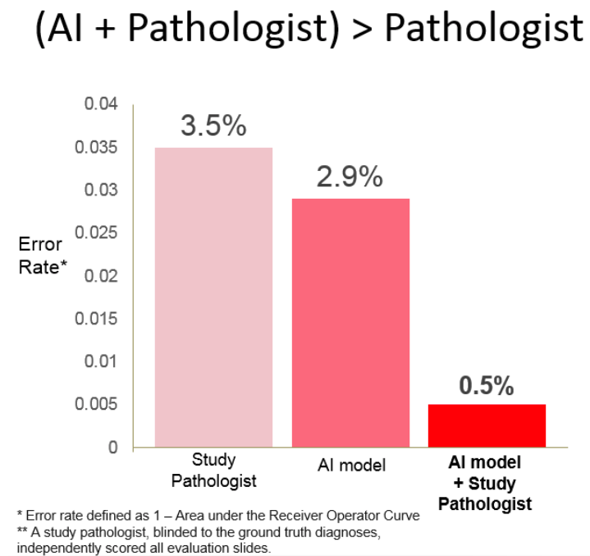

Slide 28
Dermatology
Study of 130,000 skin lesions AI AUC 0.96 for carcinoma and 0.94 for melanoma
AI vs. 58 international dermatologists to detect melanoma revealed AUC for AI of 0.86 and for doctors of 0.79
Most skin cancers worldwide are diagnosed by primary care physicians and not dermatologists and inaccuracy has been a documented problem

Slide 29
Cardiology
AI to diagnose MI on 549 ECG sensitivity of 93% and specificity of 90% similar to cardiologist readings
64,000 one lead ECG AI and cardiologist readings were similar for 14 different conduction disturbance
8000 echocardiograms analyzed by AI showed AUC 0.93 for hypertrophic cardiomyopathy, AUC 0.87 for cardiac amyloid, and AUC 0.85 for pulmonary artery hypertension

Slide 30
Gastroenterology
Finding <5 mm adenomatous or sessile polyps
Study of 325 patients with 466 tiny polyps revealed AI accuracy of 94% and negative predictive value of 96% during real time, routine colonoscopy
AI worked equally well for novice and expert
No need to inject dye to detect the polyps

Slide 31
Mental Health
350 million have depression worldwide
Digital tracking of depression and mood via keyboard interaction, speech, voice, facial recognition, sensors, and use of interactive chatbots.
Facebook posts have predicted depression diagnosis later documented in medical record
ML predicting medication usage, depression, suicide, bouts of psychosis in schizophrenia

Slide 32
Digital Phenotyping of Mental State
Speech: volume, vowel space, word choice, length of phrases, coherence, sentiment
Voice: valence, tone, pitch, intonation
Keyboard: Reaction time, attention, memory, cognition
Smartphone: activity, movement, communication, social media, tweets, emoji
Face: Emotion, tics, smiles, look at ground, eye movement, eye contact

Slide 33
USC Software
74 acoustic features
Voice quality, shimmer, pitch, volume, jitter, prosody
Predicted marital discord as well or better than therapists

Slide 34
Sandy Pentland’s Cogito
Honest signals: tone, fluidity, conversational engagement, energy
Monitor mental health of patients by recording audio diary
Real time analysis of conversation being used by insurance companies to handle customer calls
VA using with at risk veterans with 24/7 phone monitoring

Slide 35
AI and PTSD
Dave Philipps, NY Times, April 22, 2019
NYU & SRI International study
129 male vets, 32 years old, without depression, alcohol abuse
CAPS identified 52 with PTSD, 77 without PTSD
Interviews deconstructed into 40,526 features
AI searched the features and identified 18 features (flatter speech, less articulation of tongue, monotonous tone) predictive of PTSD 89% of the time
Experts thought best feature would be agitated speech

Slide 36
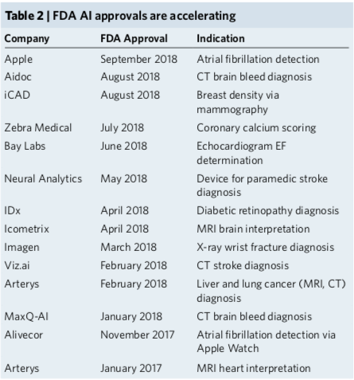

Slide 38
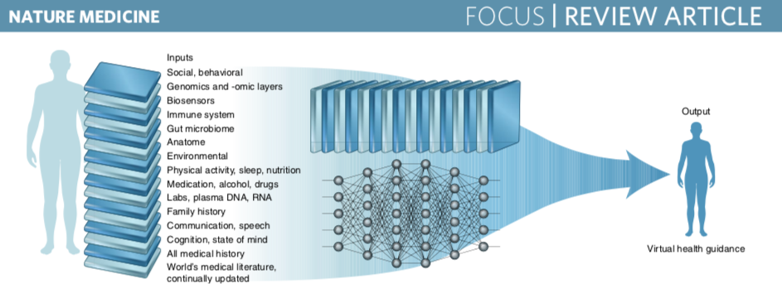

Slide 39
Michael Snyder
Nature Medicine 25, 792-804 (2019)
Predict and Prevent
53/109 learned something really important from these deep profiles
Genome, Transcriptome, Proteome, Metabolome, Microbiome
Tracked 40,000 molecules; every 3 months blood, urine, stool, cheek swabs, glucose monitors, heartbeat trackers

Slide 41
Michael Snyder
Nature Medicine 25, 792-804 (2019)
18 had Stage II hypertension
9 diabetes, but different paths to the disease
Patient with recurring strokes on wrong medicine
Genetic variant linked to enlarged weak heart
Lymphoma

Slide 42
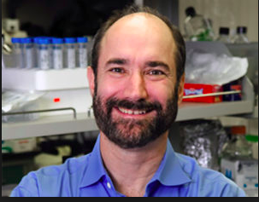

Slide 43
A.I. Versus M.D.
Siddhartha Mukherjee, New Yorker, April 3, 2017
“I think if you work as radiologist you are like Wile E. Coyote in the cartoon. You’re already over the edge of the cliff, but you haven’t looked down. There’s no ground underneath. It’s just completely obvious that in five years deep learning is going to do better than radiologists. It might be ten years. I said this at a hospital. It did not go down too well.”
Geoffrey Hinton (father of Deep Learning), University of Toronto

Slide 44
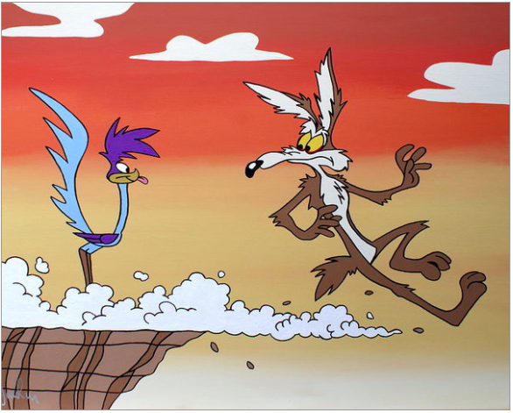

Slide 45
Babylon Health
MRCGP exam in UK tests trainee general practitioners
Average passing grade 72% over last five years
Babylon Health received 82%
Chatbot asks questions of patient to come to dx.
NHS 26,000 citizens in London switched from GP clinics to Babylon

Slide 46
A.I. Versus M.D.
Siddhartha Mukherjee, New Yorker, April 3, 2017
“I’m interested in magnifying human ability…The industrial revolution amplified the power of human muscle. When you use a phone, you amplify the power of human speech…Did the phone replace the human voice? No, the phone is an augmentation device. The cognitive revolution will allow computers to amplify the capacity of the human mind in the same manner. Just as machines made human muscles a thousand times stronger, machines will make the human brain a thousand times more powerful.”
Sebastian Thrun (Stanford, Google X) mother died of breast cancer at age 49.

Slide 47
Human + Machine: Reimagining Work in the Age of AI
Paul Daugherty & H. James Wilson, 2018
Human & machine intelligence synergistic, not competitive
Humans and AI Cobots will work together.
There are eight new fusion skills necessary for successful human and computer optimal results

Slide 48
Human + Machine: Reimagining Work in the Age of AI
Paul Daugherty & H. James Wilson, 2018
Rehumanizing Time: increase time available for distinctly human tasks like interpersonal interactions, creativity, and decision making
Responsible normalizing: Responsibly shaping the purpose and perception of human-machine interaction as it relates to individuals, businesses, and society
Judgment Integration: Ability to decide a course of action when machine is uncertain what to do
Intelligent interrogation: Knowing how best to ask questions of AI across levels of abstraction to the insights you need

Slide 49
Human + Machine: Reimagining Work in the Age of AI
Paul Daugherty & H. James Wilson, 2018
Bot-based empowerment: Working with AI to extend your human capabilities and create superpowers in business processes and careers
Holistic melding: The ability to develop robust mental models of AI agents to improve process outcomes
Reciprocal apprenticing: performing tasks with AI so they can learn new skills & on the job training for people so they can work well with AI enhanced processes
Relentless reimagining: Rigorous discipline of creating new processes and business models from scratch, rather than automating old processes

Slide 50
Why Physicians Should Learn to Code
https://www.ncbi.nlm.nih.gov/pmc/articles/PMC3622380/
Don’t want technicians to define role of physician
Boost career
Important to be able to talk to data scientists
GitHub, Medium, Stack Overflow
ProgrammingForPhysicians.com
Open access course
12 lessons
30-60 minutes each lesson

Slide 51
Adapting to Artificial Intelligence
Saurabh Jha & Eric J. Topol. JAMA November 29, 2016
Combination of big data and artificial intelligence will change medicine
Examine future of radiology & pathology
Radiology & pathology: transition from subjective perceptual skill to objective science
Operant conditioning trained pigeons to spot calcifications on mammograms and detect cancer on histology PLoS One. 2015; 10(11):e0141357

Slide 52
Adapting to Artificial Intelligence
Saurabh Jha & Eric J. Topol. JAMA November 29, 2016
To avoid being replaced by computers they must allow themselves to be displaced by computers
Radiology & pathology should merge into single entity (information specialist) whose job will not be extracting information from images and histology but to manage the information extracted by artificial intelligence in the clinical context of the patient

Slide 53
The Four Industrial Revolutions
First (1760 to 1840): the steam engine
Second (1870 to 1914): the telegraph, the telephone, the light bulb; industries powered by steam & electricity
Third (1969 to 2000): New information and communication technology (Internet) converge with renewable electricity to digitize global manufacturing
Fourth (2000 to future): Artificial Intelligence, Big Data, and Machine Learning are general purpose technologies like steam engine and electricity

Slide 54
