Slide 1


Audio/Visual Sponsored by:

Slide 2
WELCOME
Jacqueline Terrasi
Payer Day Chair
Tawnya Wartell
President
Mary Kelly, PhD
Productive Leaders

Slide 3

Mary Kelly, PhD
Productive Leaders

Slide 4


Slide 5
Using Data to Drive Value: Advancing the Triple Aim
June 16, 2022
Maria de Jesus Diaz-Perez, PhD
Director of Research and Performance Measurement

Slide 6
CIVHC Our Mission
We strive to empower individuals, communities, and organizations through collaborative support services and health care information to advance the Triple Aim: Better Health, Better Care, Lower Cost
We are:
  Non-profit
  Independent
  Objective
Notes:
CIVHC is a non-profit, non-partisan, objective organization
We were formed out of a recommendation from a multi-stakeholder recommendation of the 208 Blue Ribbon Commission on Health Care
Our mission is to serve those across Colorado working to improve health and health care, and lower costs

Slide 7









Who We Serve
Change Agents
Individuals, communities, or organizations working to lower costs, improve care, and make Colorado healthier.
Clinicians
Pharmacy
Hospitals
Employers
Government
Consumers
Researchers
Non-Profits
Health Plans
Notes:
CRS 25.5-1-204 – Advisory Committee to the APCD
(7) The all-payer health claims database shall:
(a) Be available to the public when disclosed in a form and manner that ensures the privacy and security of personal health information as required by state and federal law, as a resource to insurers, consumers, employers, providers, purchasers of health care, and state agencies to allow for continuous review of health care utilization, expenditures, and quality and safety performance in Colorado;
b) Be available to state agencies and private entities in Colorado engaged in efforts to improve health care, subject to rules promulgated by the executive director;
We work with change agents across the spectrum of health care. This includes clinicians …
With consumers and patients at the center of our focus
We work with each of these stakeholders to improve the lives of Coloradans, working to lower costs and improve care.

Slide 8



Administration of the CO APCD
Health Insurance Payers
We receive claims from Medicaid, Medicare FFS, Medicare Advantage, and over 40 commercial payers
Unique Lives
Over 5 million unique lives, representing over 65% of insured Coloradans
Claims
875+ million claims
Medical, pharmacy, and dental claims
Drug rebate information
Alternative payment model (APM) information
Notes:
CIVHC is an independent non-profit comprised of people managing resources and processes that are used by Change Agents to inform actions in support of the Triple Aim.
The CO APCD is a data warehouse. Is the largest resource we manage, which we do on behalf of the State, and in partnership with our data vendor HSRI.
All Payer Claims Databases (APCDs) typically include medical, dental, pharmacy claims collected from private and public payers.
Currently, 18 States have legislation enabling collection of health care claims data (www.apcdcouncil.org), 6 states have voluntary efforts
Colorado APCD established through legislation - 2010
CIVHC appointed by State of Colorado to administer CO APCD
CA coming online; NM has vendor bids in hand

Slide 9


How We Serve
Public Data
Civhc.org
Identify opportunities for improvement in your community through interactive reports and publications
Non-Public Data
License data from the most comprehensive claims database in CO to address specific project needs

Slide 10
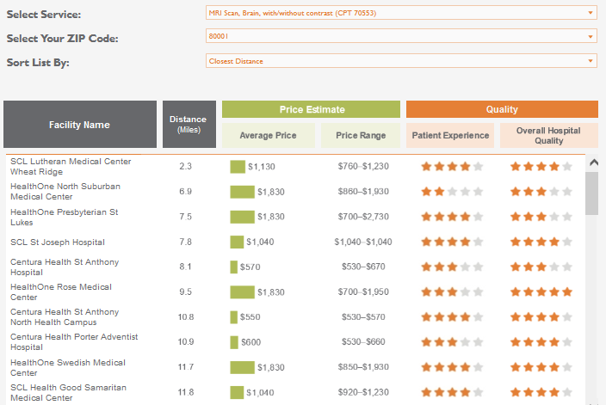
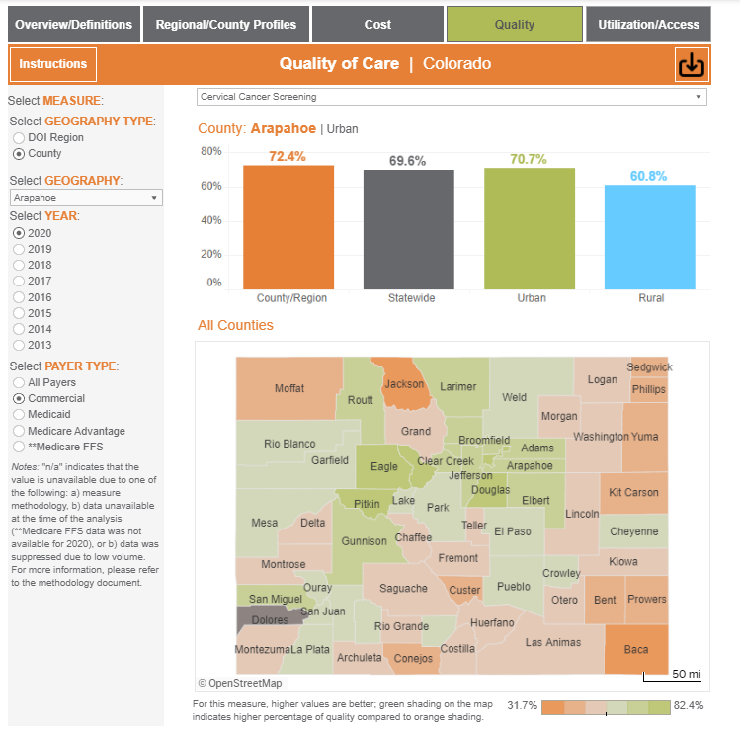
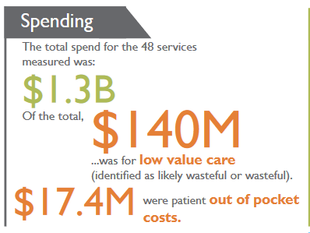
Signature Public Reports
Shop for Care Tool
Low Value Care
Medicare Reference Pricing
Community Dashboard
(cost, quality, access/utilization)

Slide 11
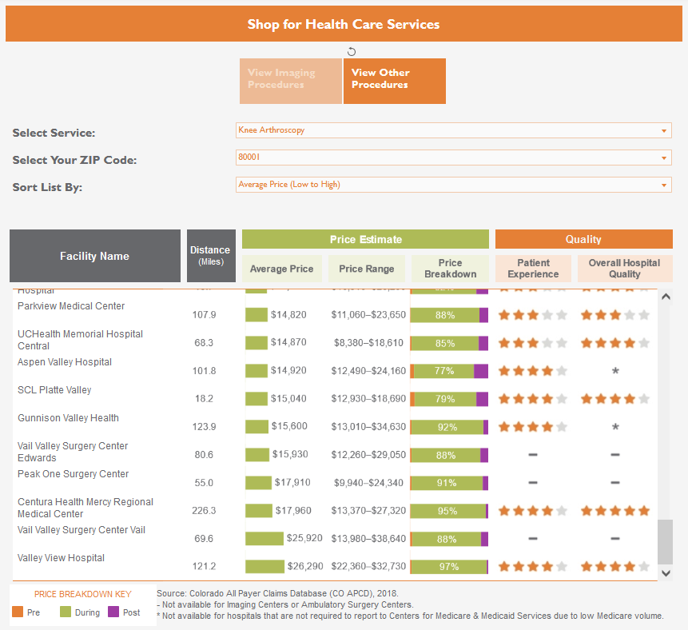
Shop for Care Tool for Consumers
Prices vary widely across services:
Knee Arthroscopy
Breast Biopsy
$3,000 - $26,000
$1,700 - $7,200
Notes:
Released in January 2022

Slide 12
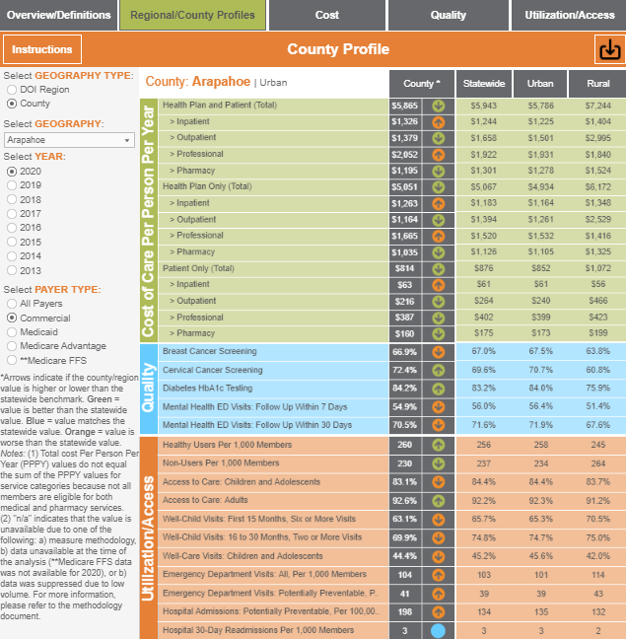
Community Dashboard
Allows users to better understand variation across:
  Cost
  Quality
  Utilization
  Access
Notes:
Released in Fall 2021

Slide 13
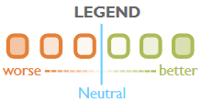
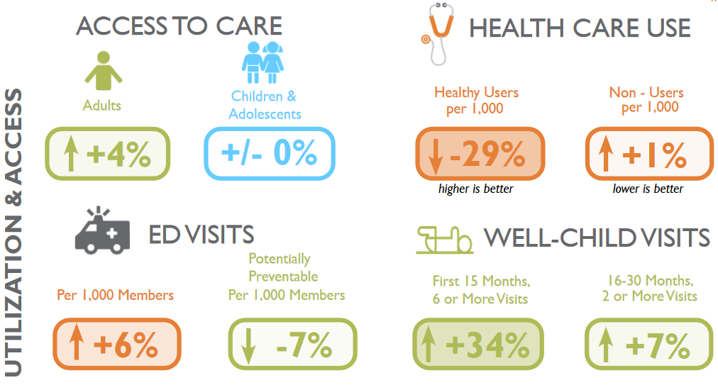
Community Dashboard Trends
All Payers, 2013-2019

Slide 14
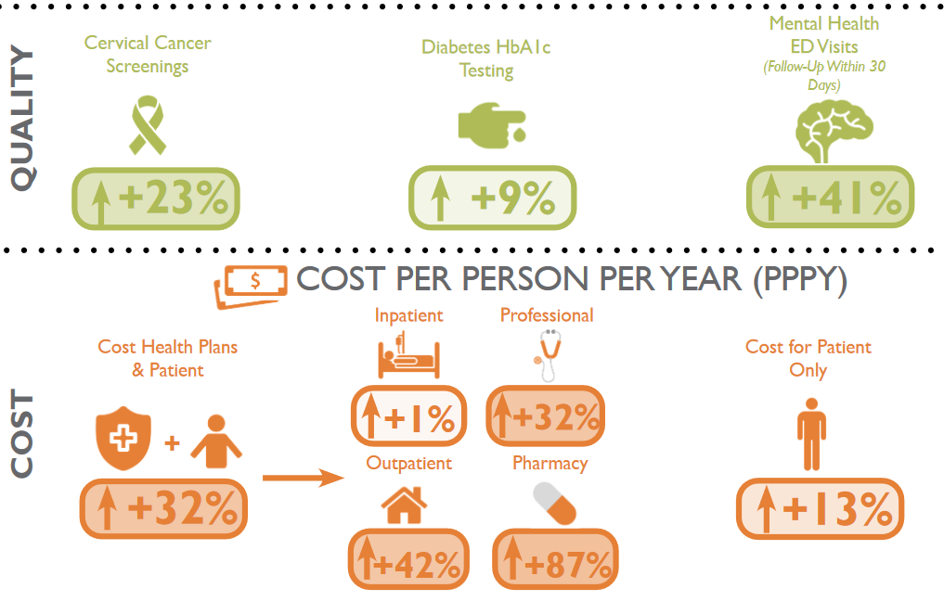
Community Dashboard Trends
All Payers, 2013-2019

Slide 15
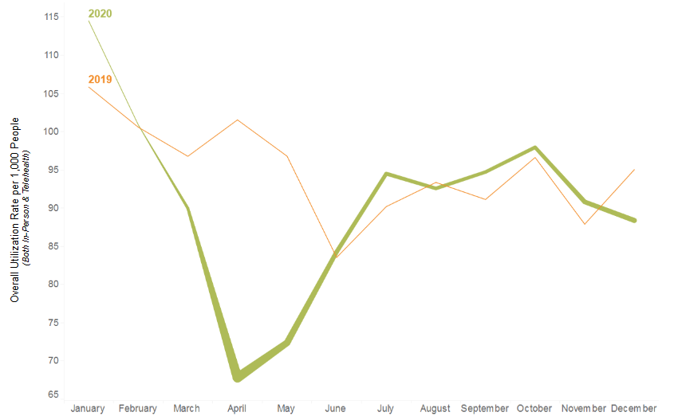
Telehealth vs. In-Person Utilization Primary Care
Primary care providers saw a 40% decrease in overall services provided from January 2020 to April 2020 despite a 7,800% increase in telehealth claims.
Thicker green line indicates higher percentage of telehealth vs in-person visits
*Medicare FFS only included in 2019
Notes:
COVID-19 and the adoption of telehealth had different effects on various sectors of the health care system.
Fall 2021

Slide 16
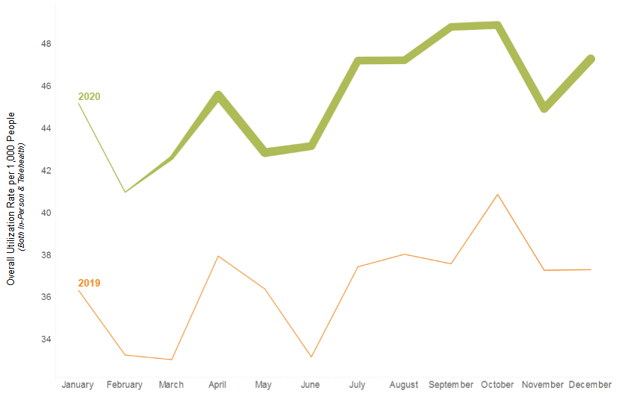
Telehealth vs. In-Person Utilization Behavioral Health
Behavioral health providers visits increased overall in 2020 compared to 2019, largely due to higher percentages of telehealth services.
*Medicare FFS only included in 2019

Slide 17
Affordability Dashboard (Currently)
Cost of Care: Health care categories that drive the majority of health care spending, including breakouts of high-cost outpatient services.
Low Value Care: Treatments and services that do not improve outcomes for patients, contribute to health care spending, and may cause harm.
Prescription Drug Rebates: Percent of prescription drug spending that comes back to payers in the form of rebates.
Notes:
Spring 2022

Slide 18
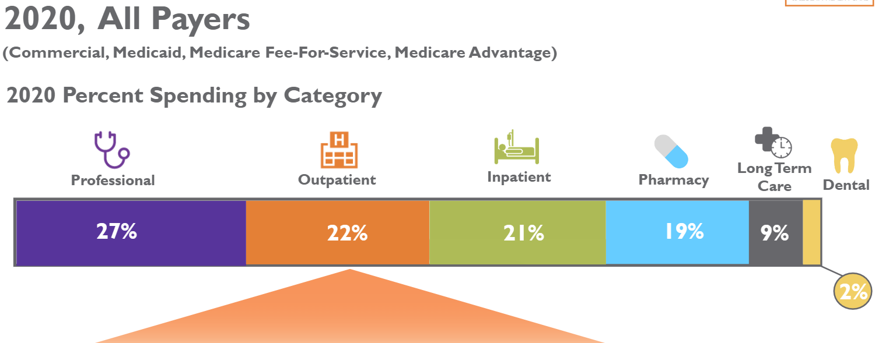
Cost of Care in Colorado

Slide 19
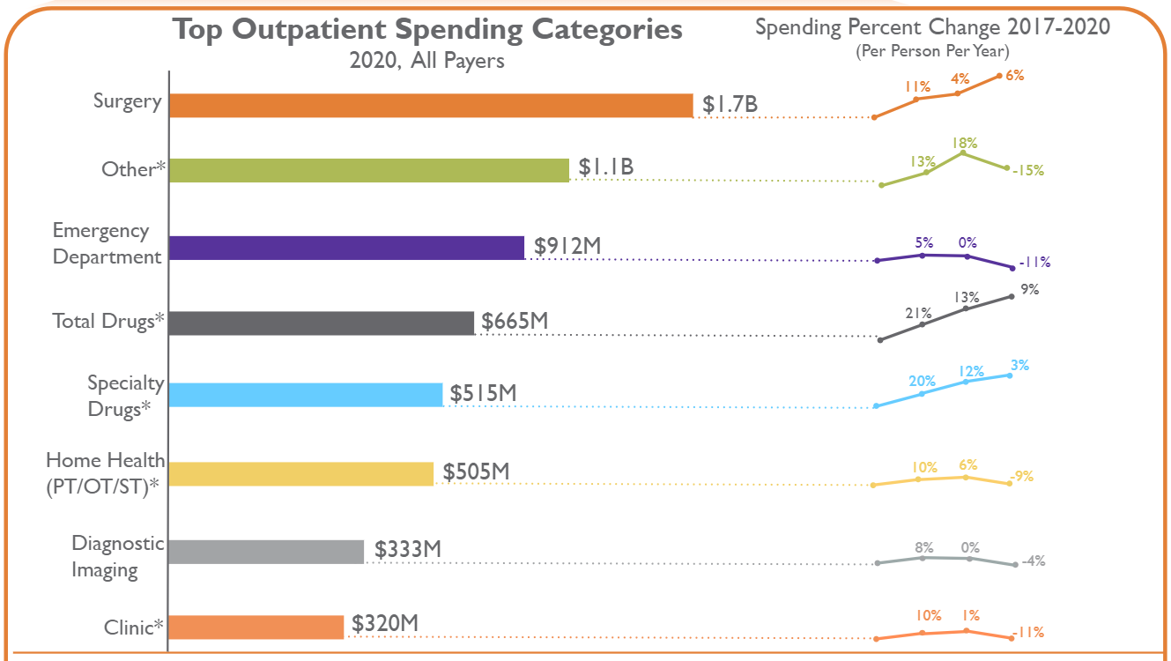
Outpatient Spending Categories: 2017-2020

Slide 20
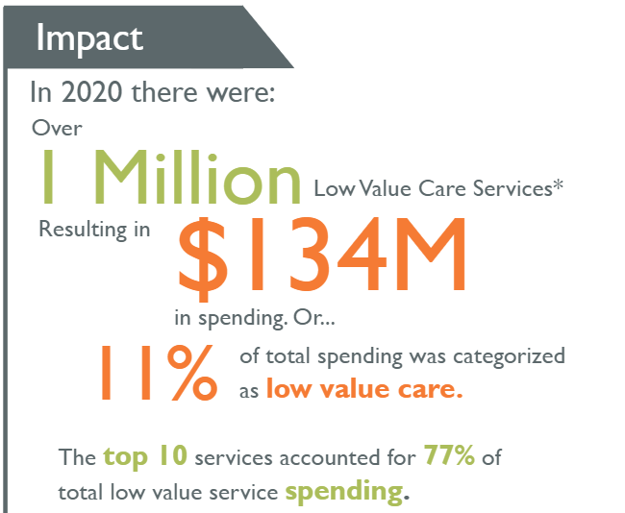
Low Value Care in Colorado
(CO APCD, 2020)
Treatments and services that do not improve outcomes for patients, contribute to health care spending, and may cause harm.

Slide 21
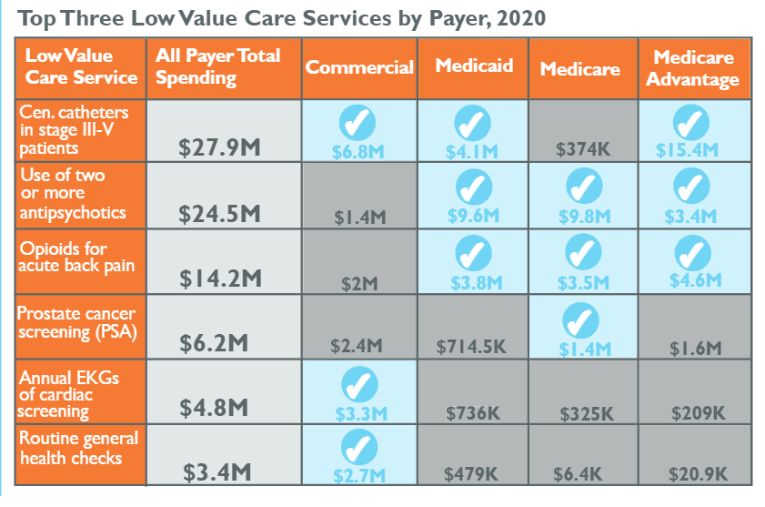
Low Value Care in Colorado
(CO APCD, 2020)

Slide 22
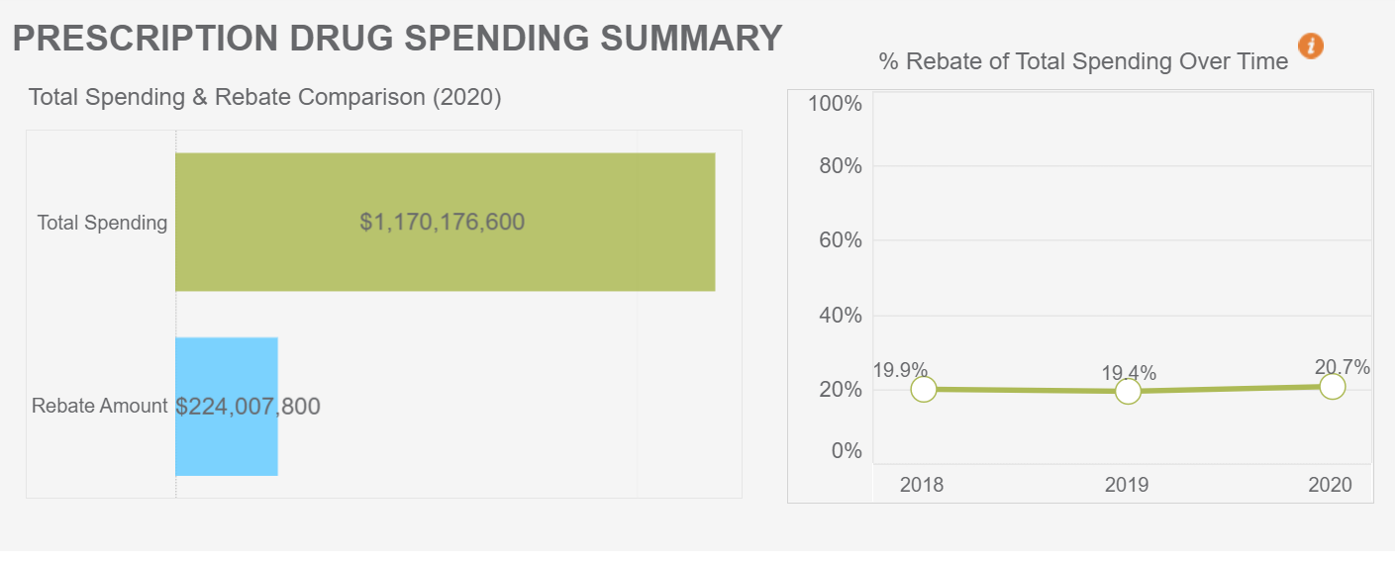
Prescription Drug Rebates (2018-2020)

Slide 23
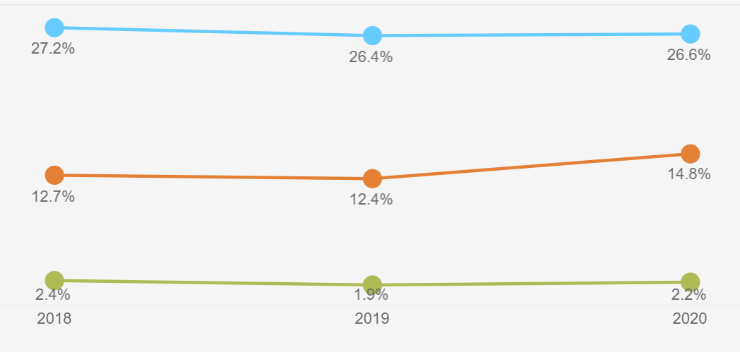
Percentage of Prescription Drug Rebate, Commercial Payers, 2018-2020
Brand
non-specialty
Brand
Specialty
Generic

Slide 24
Affordability Dashboard (Coming soon)
Alternative Payment Models
  Total Medical Spending
  Primary Care Spending
Reference Based Price
  Hospital Inpatient and Outpatient Services compared to Medicare prices
Notes:
Summer 2022

Slide 25
THANK YOU
Questions?
Maria de Jesus Diaz-Perez
Director of Research and Performance Measurement mdiaz@civhc.org info@civhc.org

Slide 26


Networking
Break
Coffee Sponsored by:

Slide 27


Slide 28

Value-Based Care

Slide 29
What is Value-Based Care?
The improvement of quality and outcomes for patients
  Everyone wins: Payors, Physicians and Patients
Goals of VBC:
  Practicing evidence-based medicine
    Using systematic reviews of medical literature to evaluate the best evidence on clinical topics
    Ex: Knees- Physical therapy prior to surgery
  Wellness and prevention
    Diabetes:
      Controlling blood sugar
      Healthy diet
      Emotional/Psychological issues
      Managing
      Controlling A1C
  Reducing unnecessary costs
    Example: ER visits
Innovative Collaboration
Awareness
Support Care Teams
Delivery of Excellent Patient Care
Improve Health Outcomes
Reduce Medical Costs

Slide 30
What is an ACO/CIN?
An ACO/CIN is a network of interdependent physicians, healthcare facilities and other providers that work collaboratively to develop and sustain clinical initiatives through evidence and data driven care.
The goal of an ACO/CIN is to reduce operating cost and redundancy in overall patient care, practice evidenced based medicine, through better integration of care, which would predictably improve the patient and physician experience.
The ultimate ACO/CIN has a group of primary care physicians, specialty physicians, hospital(s), post-acute facilities, home health and ancillary services actively participating in a streamlined care delivery model.

Slide 31
Fee-for-Service Vs.
Value-based Contract?
Fee-for-Service Contracts
Value-Based Contracts
Paid on a per service basis.
Physician or staff sees a patient and bills and receives payment for that visit or service.
Gets prepaid for medical management services.
Gets bonuses for cost containment if population health goals are realized.
Gets bonuses for quality measures if population health goals are realized.

Slide 32
Clinically Integrated Networks
Driving Better Quality And Lower Costs
Lower Costs
Waste & Inefficiency
Waste & Inefficiency
Payment for
All Other Care
Payment for
All Other Care
Shared Savings
Total Physician Payment
Total Physician Payment
FFS Payments to Providers
Care Coordination Payment
FFS Payments to Providers
Fee for Service Model
Pay for Value Model

Slide 33
Evolution of Value-based Care Contracts
Plan of Patient Care: Evidence Based Care Coordination: Right Time & Right Place
Pay for Performance
Upside Risk
Downside Risk
Professional Capitation
Increased
Revenue
Chronic Disease Care Management

Slide 34
The “Value” in Value Based Care
Quality
Affordability
Physician Satisfaction
Service

Slide 35


Slide 36
WORKING WITH CIGNA
Colorado Payer Day 2022
Notes:
Lead in Message:

Slide 37
Cigna Commercial
Prior Authorizations
  Timely
  Use the tools available – Cigna Master Precertification List
No Surprise Billing
  Cigna is complying with all applicable laws
  Provide timely current demographic information
Credentialing
  Current with credentialing turnaround
  LBGTQ+ data
Important tools to use
  CignaforHCP.com
  Network News
Interview
Conducted in the early enhancement planning stages
Used to gather insights on provider workflows and processes to inform us how to best build solutions
Time commitment:
30-45 minutes
Usability testing
Answer questions – or have an opportunity to test – the navigation and usability of a design prototype.
Time commitment:
30 minutes.

Slide 38
Cigna Medicare Advantage
Prior Authorizations
  Systems are different than Cigna Commercial (HSConnect and eviCORE for specific requests)
  As of 6.1.2022, eviCORE now auths DME, Home Health and Post Acute Care
Credentialing
  Same systems and complaint with the 60 day turn around time
  Be sure to have CAQH applications up to date, as this is the leading cause to slow downs
Important tools to use:
  Cigna Medicare Advantage website
    Cigna Medicare Insurance Providers | Cigna

Slide 39
All Cigna products and services are provided exclusively by or through operating subsidiaries of Cigna Corporation, including Cigna Health and Life Insurance Company, Connecticut General Life Insurance Company, Cigna Behavioral Health, Inc., and HMO or service company subsidiaries of Cigna Health Corporation. The Cigna name, logo, and other Cigna marks are owned by Cigna Intellectual Property, Inc.
All models are used for illustrative purposes only.
PCOMM-2021-098 01/21 © 2022 Cigna. Some content provided under license.

Slide 40


Slide 41
Colorado Access Provider Network Services

Slide 42

Provider Network Services
Services We Provide
We provide trainings and education Colorado access systems, rules, processes, and offerings. We also offer provider education around new initiatives, programs, and provide high-level issue resolution. We hold new provider orientations for any provider that is new to our network. Our communication platforms – such as our provider newsletter, Navigator – help you stay informed. We offer training on the various systems you use, such as the provider portal, claims submission, clearinghouse, etc. We also can help you understand HCPF systems like the DAP and eligibility portal
Our Promise to You
We are with you throughout your tenure as a contracted provider within our network by continually supporting, training, educating, and communicating with you. When you have a question about our programs and offerings, you can contact your provider network manager. If you have an issue or problem, you can call your provider network manager and the problem will be quickly addressed and remedied
How We Can Help
We are here to help you understand what you need to know as a provider in our network. Through our education and training, we’ll help you navigate through the entire process of being a contracted provider with Colorado Access. Provider Network Services and more importantly, your provider network manager is your single point of contact for all things Colorado Access. Let us help!
Contact Us
We’re here to help! You can contact us at 720-744-5667 or 844-430-6684 or by email at providernetworkservices@coaccess.com

Slide 43
Colorado Access On-Boarding For Providers What is Included
Colorado Access Provider Portal
Navigator Newsletter
Provider Learning Management System (LMS)
Uniform Services Coding Manual (USCM)
Reimbursement

Slide 44


Connect With Us
Colorado Access Provider Portal
  Pulling Report (PEPR, EOP, KPI Performance
  Check Claim Status
  Submit Appeals
  Verify Eligibility
Navigator Newsletter
We send out periodic newsletters to our providers by email. You can also find recent editions below. Each edition contains important news related to Colorado Access and our members. If you are not already receiving our provider newsletter, please send an email to providercommunication@coaccess.com.

Slide 45

Provider Learning Management System (LMS)
Our online learning management system (LMS) contains all the information you need to navigate as a Health First Colorado (Colorado’s Medicaid Program) or Child Health Plan Plus (CHP+) provider with Colorado Access. You will have access to any on-demand pieces of training, presentations, and webinars we offer.
Some of the categories are
  Access to Care Standard
  Medicaid 1 on 1
  Behavioral Health Comprehensive
  Provider Documentation Training

Slide 46

Uniform Services Coding Manual (USCM)

Slide 47
Reimbursement Options

Slide 48
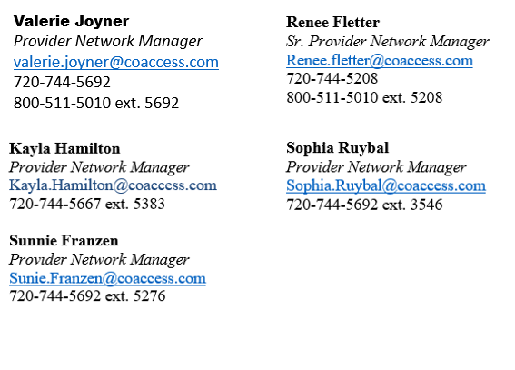

COA Provider Network Managers providernetworkservices@coaccess.com

Slide 49


Slide 50
CMGMA Payer Day 2022
Marie Baker VP Provider Market Operations for the Mountain States

Slide 51
Agenda
Prior Authorization
No Surprises Billing Act
Credentialing

Slide 52
Prior Authorization

Slide 53
https://www.uhcprovider.com/en/prior-auth-advance-notification.html
We try to make it easy to do prior auth. Everything is on our portal – here is an example of what is on the portal when you type in Prior Authorization:
Prior Authorization and Notification
Retiring Admission Notification Fax Numbers
In this section you will find the tools and resources you need to help manage your practice’s prior authorization and notification requirements, with program specific information available for Cardiology, Oncology, Radiology, Clinical Pharmacy and Specialty Drugs.
Your primary UnitedHealthcare prior authorization resource, the Prior Authorization and Notification tool, is available on the UnitedHealthcare Provider Portal, UnitedHealthcare’s self-service tools for providers. Learn more.
Radiology Prior Authorization and Notification Resources
Plan Requirements for Advance Notification/Prior Authorization
What Would You Like to Do?
To see more information on any of these areas, open a section below to view more information.
Expand All
Determine if Notification or Prior Authorization is Required for a Patient and Service

Slide 54
https://www.uhcprovider.com/en/prior-auth-advance-notification.html
Submit a Request for Prior Authorization and Notification
Check the Status or Update a Previously Submitted Request for Prior Authorization
Requesting a peer to peer review
Upload Medical Notes or Other Attachments to a Request
Information on Prior Authorization Programs for Cardiology, Oncology, Radiology, Clinical Pharmacy and Specialty Drugs
Submit or Check Status of Prior Authorization for Prescriptions
Submit or Confirm a Genetic & Molecular Lab Testing Notification/Prior Authorization Request
We’ve Retired Fax Numbers Used for Medical Prior Authorization
Retiring Admission Notification Fax Numbers
Submit a Pre-Service Appeal and or Grievance for a Medicaid Member
All these services have the option to expand and give additional information. Additionally, you can search for Forms, State Specific Resources as well as Additional Resources.

Slide 55
https://www.uhcprovider.com/en/prior-auth-advance-notification.html
An example of what you can find when you expand the fields is:
Information on Prior Authorization Programs for Cardiology, Oncology, Radiology, Clinical Pharmacy and Specialty Drugs
  For information on specific prior authorization and notification clinical programs by specialty, choose from below:
  Cardiology
  Clinical Pharmacy and Specialty Drugs
  Oncology
  Radiology
If you choose Clinical Pharmacy and Specialty Drugs:
It will take you to several different options including but not limited to:
Medical Necessity
Step Therapy
Supply Limits
View Clinical Pharmacy Requirements
Specialty Drugs Prior Authorization Program

Slide 56
https://www.uhcprovider.com/en/prior-auth-advance-notification.html
It will also give you information on the Precheck MyScript Tool
PreCheck MyScript Tool: Check Pharmacy Eligibility & Prior Authorization
Check current prescription coverage and price, including out-of-pocket prescription costs for UnitedHealthcare members at their selected pharmacy with the PreCheck MyScript Tool in the UnitedHealthcare Provider Portal.
Get information on lower-cost prescription alternatives, if available, to help save members money.
See which prescriptions currently require prior authorization or are non-covered or non-preferred.
Request prior authorization and receive status and results.
Learn More about PreCheck MyScript tool.

Slide 57
Prior Authorization and Notification | UHCprovider.com
We also offer training on the Prior Authorization and Notification Process
Prior Authorization and Notification
A Better Way to Do Your Work
Use the Prior Authorization and Notification tool to check prior authorization requirements, submit new medical prior authorizations and inpatient admission notifications, check the status of a request, and submit case updates such as uploading required clinical documentation.
Self-Paced User Guide
Register for Live Training
Benefits and Features
Determine if notification or prior authorization is required using just the procedure code and plan type or based on a patient’s plan and detailed case information.
Submit a new request for medical prior authorization or to notify UnitedHealthcare of an inpatient admission.
Check the status or update a previously submitted request for prior authorization or notification using the reference number or member or provider information. You can also request a case be canceled without having to call.
Upload clinical notes or attach medical records and images to a request.
Provide pertinent clinical information as requested at the time of your initial submission, which may allow for quicker decisions and improved efficiency for online submissions.
Go to Prior Authorization and Notification

Slide 58
No Surprise Billing Act

Slide 59
No Surprise Billing Act
The No Surprises Act prohibits surprise medical bills and is designed to hold consumers harmless in connection with reimbursement disagreements between a health insurer or group health plan and out-of-network providers. In addition, the law requires that certain information about estimated costs be provided to patients in advance of scheduled medical services. These provisions were effective for plan or policy years beginning on or after January 1, 2022.
The No Surprises Act is a law establishing federal standards to resolve surprise bills for:
Fully insured individual
Small group, and large group markets and for self-insured group plans
Exchanges, grandfathered and transitional relief plans for plan and policy years
Federal Employees Health Benefits Program.
Self-funded UMR plans and Level Funded (All Savers) plans are also included.
The law applies to emergency services at out-of-network (OON) hospitals and free-standing emergency facilities, OON providers at in-network (INN) facilities, and OON air ambulance carriers.

Slide 60
No Surprise Billing Act
How does UnitedHealthcare plan on addressing these requirements?
As with other federal and state laws, UnitedHealthcare is committed to comply with the new requirements and to keep our clients informed on UnitedHealthcare’s approach and options for self-funded clients.
Under the No Surprises Act member cost-sharing for covered out-of-network (OON) services is based on the “recognized amount” which is determined as follows:
  By applicable state law in states that have a methodology to determine the payment amount for such items/services
  If the state does not have a state law to determine the payment amount, the “qualifying payment amount.”
    The qualifying payment amount is generally the median of contracted rates for a specific service in the same geographic region within the same insurance market.
How are prior authorization, coverage limits, and member cost-sharing treated for OON services subject to the No Surprises Act?
  Insurers/health plan are prohibited from requiring prior authorization for OON emergency services and may not apply coverage limitations for OON emergency services that are more restrictive than those for INN services.
  Insurers/health plans cannot apply cost sharing for OON covered items and services that is greater than cost-sharing applied to INN covered items and services (e.g., 10% coinsurance for same INN and OON covered items and services). All OON cost-sharing must be counted toward any INN deductible and cost-sharing limits.

Slide 61


Slide 62


Slide 63
Welcome to Friday Health Plans

Slide 64
Why Friday Health Plans
Friday Health Plans was specifically built to bring affordable and simple health insurance to the market.
We put our members and providers first with a consumer-centric approach.
We are a provider friendly health plan: we offer minimal prior authorizations, timely claims payments, easy-to-navigate provider manual, and a quick response to provider inquiries.
Easy to use provider portal where providers can check authorization status, access claims
data, review member, and more!
We have local provider relations and contracting team in every market to effectively support our provider partners.
Our net-promoter score (customer satisfaction) is much higher than our ACA and other health plans competitors.
We offer an innovative benefit design with access to free unlimited PCP and mental health visits in MOST plans, access to thousands of generic drugs, and more.
Friday Health Plans is projected to continue to grow significantly in the upcoming years.

Slide 65
We’re Purpose Built for Consumers
Consumer Focus | Innovative Product and Network | Enabled by World Class Tech Platform
Product, network, formulary, Service, experience, marketing all custom built just for individuals and families | Most of our plans include unlimited $0 PCP visits, mental health counseling, & virtual Teladoc doctor visits | Simple benefit and network design is easy to administer
All ACA compliant – no “junk” insurance | 4900+ free generic drugs | Implemented and integrated new systems for enrollment, claims, medical and analytics
Adding simplicity to health insurance Single network per state Single set of covered services across all metal tiers Helping customers understand health insurance | Wide network of PCPs, peds, OB/Gyns, and mental health provide great access
 | Narrow network of facilities and high-cost specialists to provide value

Slide 66





Our Founders
Salvatore Gentile - CEO
David Pinkert - President
Colorado PRC Team
Jackie Young
Kathryn McGee
Keri Matsunaga-Gottlieb

Slide 67
Company Background
2015
  Company launch.
2017
  Acquired Colorado Choice Health Plans. Built network in rural Colorado.
  Fix broken processes in risk adjustment, underwriting and claims processing.
2018
  Expanded to new markets in Colorado. Achieved first profit.
  Implemented new product and formulary design.
2020
  Raised $50M in capital for new state expansions.
2021
  Go live in Nevada, New Mexico, and Texas.
  Secured $160 million in funding.
2022
  Go live in North Carolina, Georgia, and Oklahoma and 12 additional counties in Colorado.
  Raises $120 million in new funding.
2023
  Pending to go live in Tennessee, Florida, Pennsylvania, Virginia and 9 additional counties in Colorado.

Slide 68
Benefits People Want and Use
$0 benefits, before deductible
  Unlimited PCP visits*
  Unlimited virtual Teladoc doctor visits
  Unlimited mental health visits*
  Thousands of generic drugs
$75 urgent care clinic visits*
*On many, but not all plans

Slide 69





Slide 70

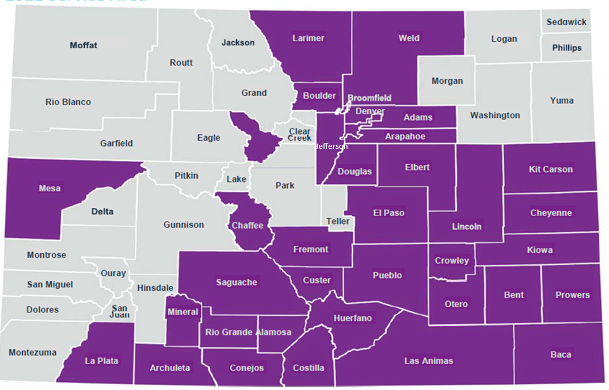
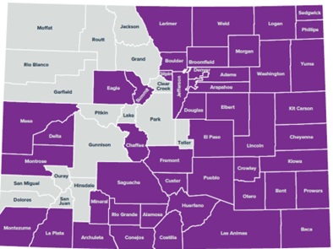
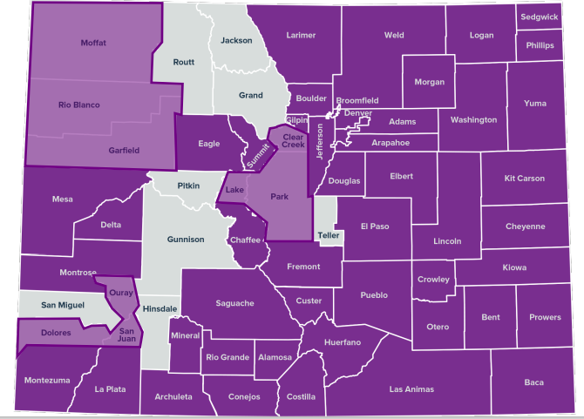
Our Mission
Friday Health Plans’ mission is to empower more people to choose their own health insurance by offering plans that are affordable, simple and friendly – purpose-built for the modern healthcare consumer.
Our Current Service Area
Friday is licensed in the following Colorado counties:
2021 2022 2023
We are expanding to several additional counties in 2023 and beyond!

Slide 71
Products/Credentialing
Our Products:
We are licensed by the Division of Insurance as a commercial carrier and offer Small Group (Colorado only) and Individual benefit plans. Qualified Health Plans are offered to individuals both outside and inside of the state health insurance marketplace, Connect for Health Colorado.
Products updates:
- We removed Medicare (Cost) end of 2021.
- We are removing CHP+ end of June, 2022. All members will be automatically enrolled in another CHP+ MCO (Colorado Access, DH, Kaiser, RMHP) effective July 1st.
The Friday Health Plans Portal is your one-stop shop where you can:
Check authorization statuses
Access claims data
Search the Friday Formulary
Review the provider manual
See member eligibility
Credentialing: Already In-Network? Providers@FridayHealthPlans.com
Interesting in joining our network of providers? Please reach out!

Slide 72
Prior Authorizations
Request Form is easily accessible on our website under Provider Forms & Tools
  Form can be faxed to 1-888-500-1513
  Initiate over the phone at 1-800-475-8466 or via email at CO-medical@fridayhealthplans.com
  We do require PA and notification of admission for inpatient stays.
  Unscheduled OB requires notification.
  We no not require PA or notification of emergency services
Prior Authorization list is available online. All planned admissions require PA and unplanned admissions require notification.
  All DME >$500
  Any in-office procedure or injectable >$1000
  Rehabilitation therapy visits (>20 visits), OON, home services, etc.
  Please visit more conclusive list online.
  Pharmacy Benefit Manager is Capital Rx.
Legislative Changes:
  Alternatives being looked into as we gather data on provider adherence rates.
  Exploring ideas on any alternate program type.
  Always continuing to review our requirements and reduce services requiring PAs while remaining in line with standards of care, cost and utilization patterns.
Notes:
Pharmacological Prior Authorizations: Any prescriptions requiring approved PA prior to being filled are submitted to out Pharmacy Benefit Manager (Capital Rx) who approves or denies request. Capital Rx then advise member and provider of outcome and if denied, advised of the appeal process.
All buy and bill pharmaceuticals are treated with same care and urgency as all other PAs. Not all medication required PAs and FHP looks at medications in the same way and medical procedures.
Rehab Therapy includes chiro, PT, OT, ST. We have moved our chiropractic network under Columbine Chiropractic.

Slide 73

No Surprise Billing Act
Requirements:
  Friday Health Plans follows the requirements that are currently being shared by the State of Colorado.
  We are following all guidelines for the different services and areas according to the No Surprises Act for Colorado.
  Not currently requiring or requesting rosters from OON groups.
  Our claims system is configured to pay automatically at the No Surprises Act pricing per the bill.

Slide 74

How do I learn more?
1-800-474-8466 Provider Service
Providers@FridayHealthPlans.com (Credentialing, System, Loading, Directory, etc.)
Questions@FridayHealthPlans.com (Customer Service, Member Issues, etc.)
All claim issues are managed directly by our local Friday Care Crew!
For contract specific questions, contact our team at:
  CO-Medical@FridayHealthPlans.com

Slide 75


Networking
Lunch
Sponsored by:

Slide 76


Slide 77


Slide 78
Utilization Management(UM)
State Plan Benefits
Presented by: Katie Denney
Notes:
I am here to speak to you today on the Utilization Management program, known as the ColoradoPAR program, for fee for service medical state plan benefits.

Slide 79
What do we PAR?
Diagnostic Imaging
Durable Medical Equipment
EPSDT Exceptions
Molecular Testing
Select Surgical Procedures including Transplants, Gender Confirmation, Bariatric, etc.
Pediatric Behavioral Therapy
Pediatric Personal Care Services
Physician Administered Drugs (PAD)
Outpatient Physical, Occupational, and Speech Therapy
Pediatric Long Term Home Health (PLTHH)
Private Duty Nursing (PDN)
Audiology
Synagis (seasonal)
Inpatient Hospital Review Program (IHRP)
Out of State Inpatient Stays
Notes:
Kepro is currently responsible for completing prior authorization of the services on this slide in black colored font. (Read them)
The prior authorization requirements for IHRP and PLTHH are currently paused.

Slide 80
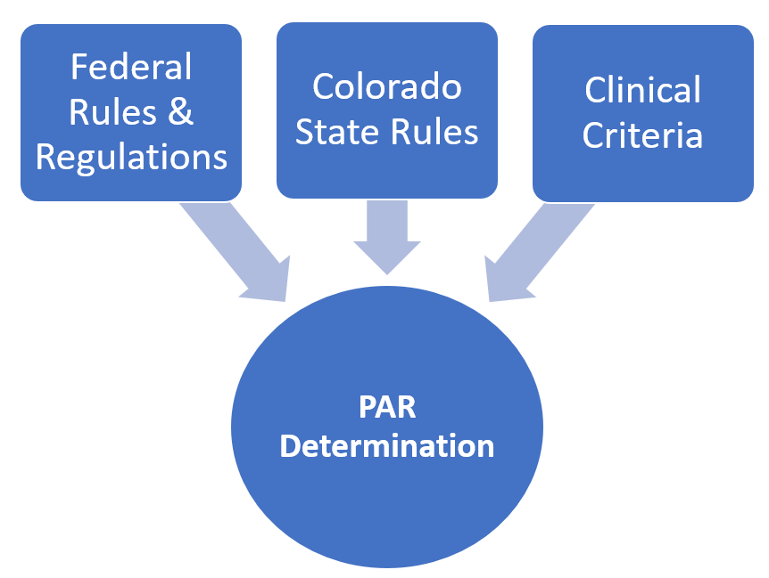
Why can it be difficult to get an Authorization?

Slide 81
Steps to get a PAR
Provider determines with Member that a service/benefit is needed and that PAR is required
Gathers all documentation, orders and tools and submits authorization via PAR portal
UM Vendor reviews for completeness. If incomplete requests add’l doc and returns to Provider
Once Provider returns auth with all necessary documentation, UM Vendor reviews for compliance & medical necessity
If denied, Providers can view denial letter in PAR portal, and members are sent denial letter with clinical rationale if denied for MN.
Approval or denial is sent to the claims management system, interchange, nightly.
If compliant & medically necessary approves request. If auth isn’t compliant and/or medically necessary (in part or whole) that portion of auth is denied.
Notes:
This slide will walk through the life of a PAR. (go through each phase)
For a standard prior authorization request, Kepro has 10 business days to render a decision if all documentation and information is present at the time of the review.
There are other types of requests that have different turnaround times that your provider can choose depending on the clinical situation.
For questions on the status of a prior authorization request, the different types of review, and/or turnaround time, please follow up with your provider.

Slide 82
Modernizing the ColoradoPAR program
Increasing and Improving automation in the PAR portal
Evaluating automation and bypass programs for successful Providers and/or certain circumstances
Improving PAR portal
Modernizing and improving provider outreach and training
Identifying Care Coordination opportunities
Notes:
We are currently in the process of developing plans or researching several methods to continue modernizing the ColoradoPAR program along with our UM Vendor, Kepro. These modernizations include…

Slide 83
More information
ColoradoPAR Program
  hcpf_um@state.co.us
Physician Administered Drugs
  HCPF_PAD@state.co.us

Slide 84
Questions?

Slide 85
Thank you!

Slide 86


Slide 87
MGMA Payer Day June 2022
  Lynne M. Berg
  Provider Engagement Executive- Specialty Care

Slide 88
Humana Agenda
Prior Authorization Experience
Resource Examples (1 pagers for provider practices)
Streamlining Prior Authorization and Referrals
Authorization Management App
Availity
Health Help
Humana Solution to Prior Authorization Burden- Cohere
Handouts Available at Humana Table

Slide 89



Slide 90
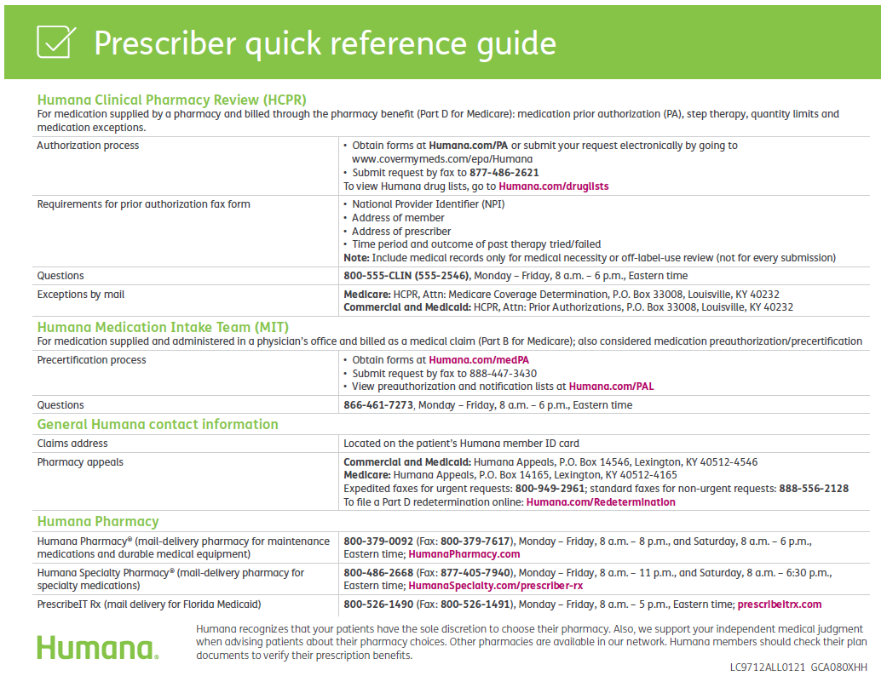
Helpful Phone Numbers

Slide 91




Slide 92
Availity Portal
Notes:
Now, let’s take a look at Availity Portal tools.

Slide 93
Humana and Availity
Availity is Humana’s electronic data interchange (EDI) clearinghouse and our preferred multipayer portal for healthcare providers.
Humana co-founded Availity and is one of several current payer-owners.
  Availity Portal advantages
One user ID
and password, many payers
Up-to-date
and user-friendly interface
No cost to register or
use the tools
Dedicated customer service line
Extensive
online help
and training
Notes:
Availity is Humana’s clearinghouse for electronic transactions with healthcare providers. And, as you can see, Availity offers several advantages.

Slide 94
Availity features for healthcare providers
Registration & navigation
Preauthorizations
& referrals
Appeals
Overpayments
Eligibility &
benefits
Claims
Remittances
Notes:
These are some of the key Availity features we’ll cover in this session, from registering to use the portal through managing overpayments.

Slide 95
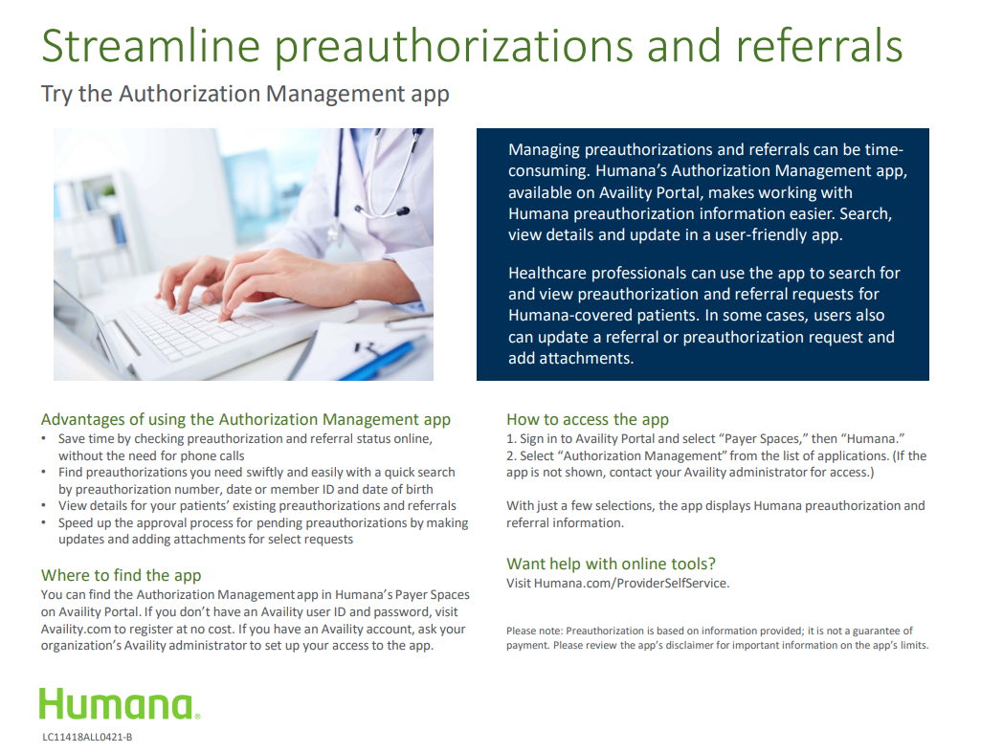

Slide 96
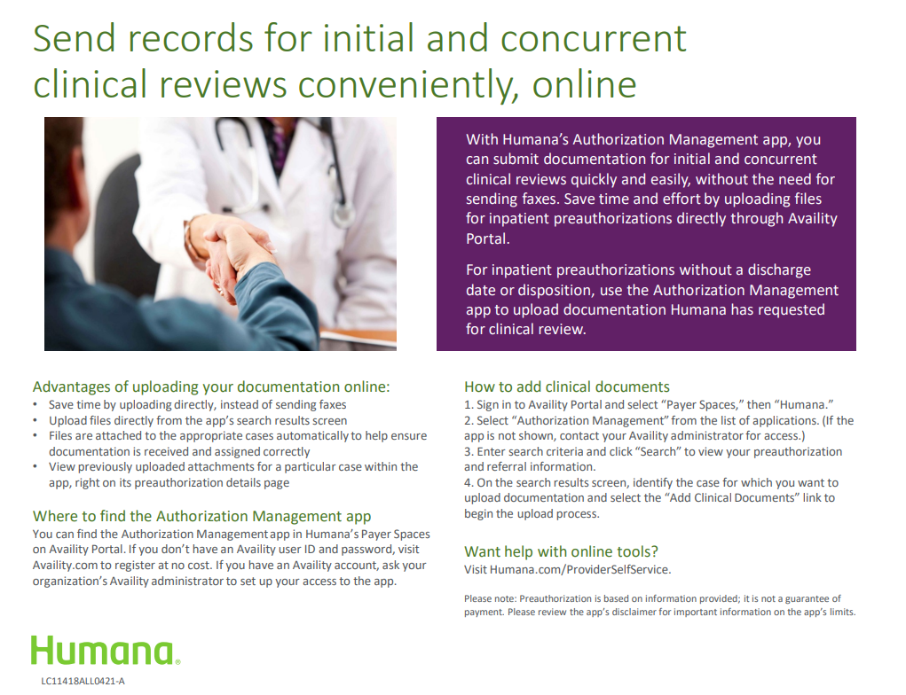

Slide 97
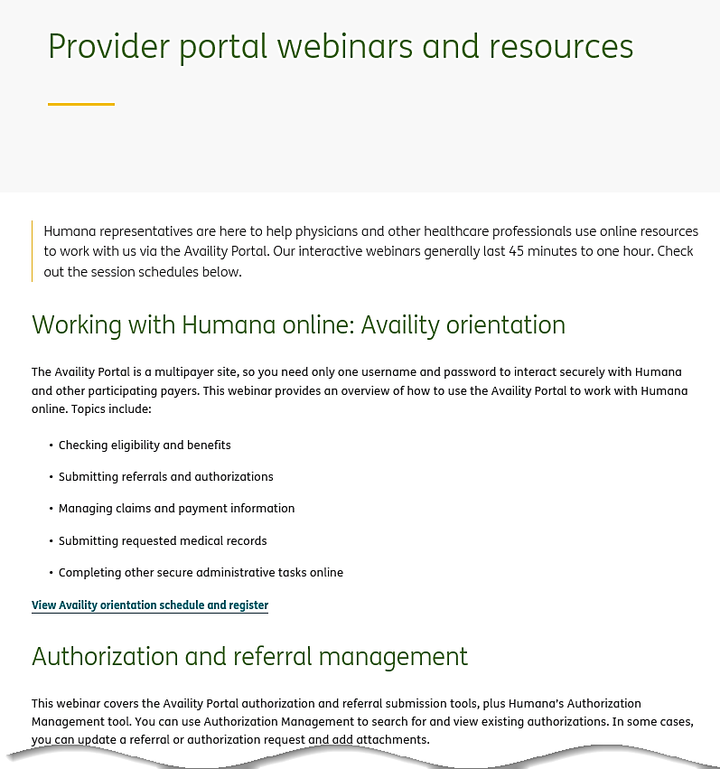

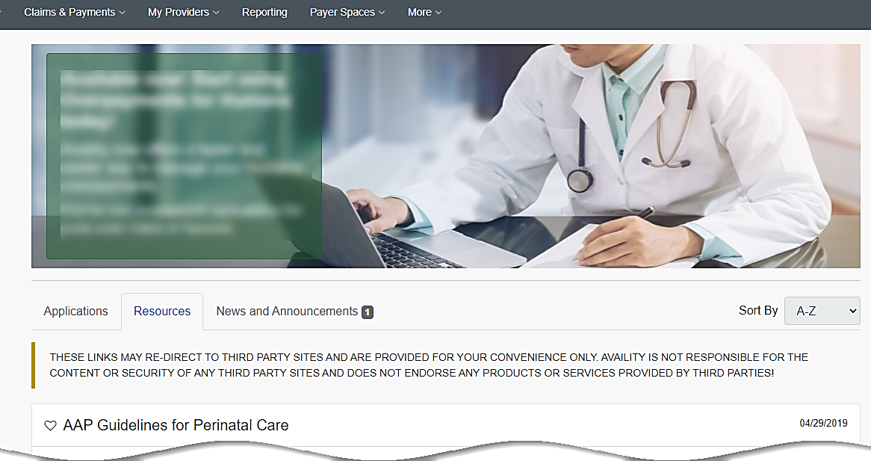
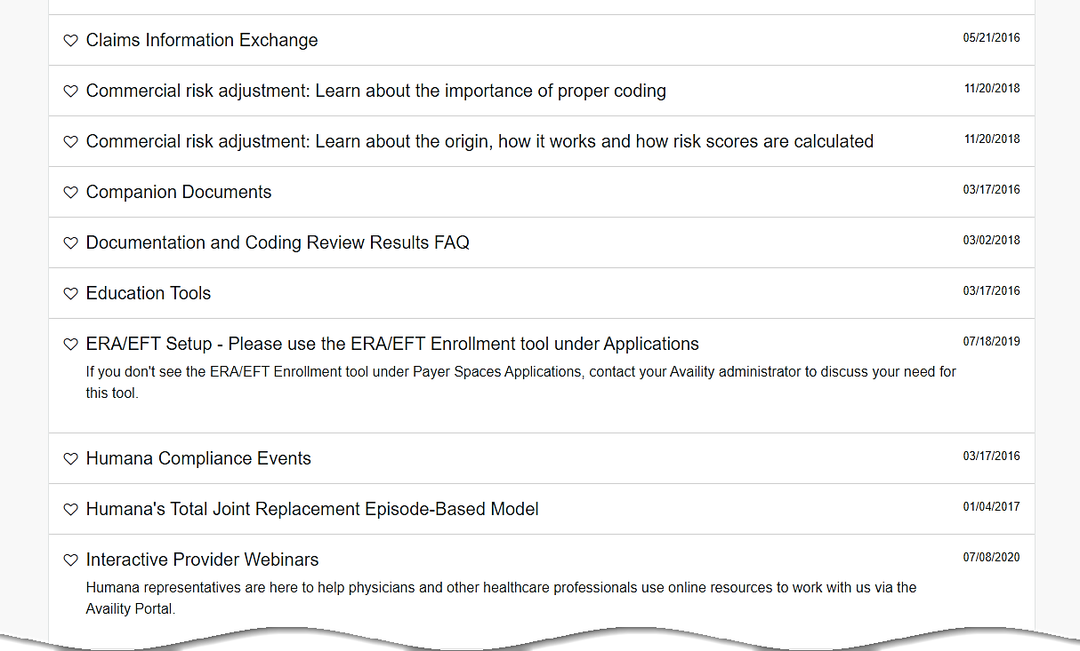
Register for other Humana-led training
A link to additional Humana-led training opportunities is in the Humana Payer Space, under the “Resources” tab.
  Or go directly to the webinar list at Humana.com/ProviderWebinars.
Notes:
To learn more about how to use Availity Portal for your patients with Humana coverage, you can sign up for a Humana-led webinar offered via phone and internet. A link to our current offerings can be found in the Humana Payer Space on Availity Portal, under the “Resources” tab.
Clicking that link takes you to a page on Humana’s public website where you can learn about and sign up for a Humana-led webinar.
Or, you can go directly to this Humana webpage by typing “Humana.com/ProviderWebinars” in your browser.

Slide 98
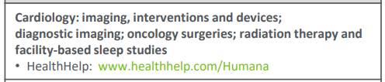
Health Help
Notes:
Now, let’s take a look at Availity Portal tools.

Slide 99
The primary goals of HealthHelp managing Authorizations are:
    Reduce unnecessary utilization
    Educate ordering providers on most appropriate clinical criteria
    Impact and savings that are targeted for managed modalities
Providers can utilize HealthHelp’s online Consult platform for authorization and best-practice guidelines.
  WebConsult online users can submit prior authorizations, Retro & STAT procedure requests online at https://portal.healthhelp.com/Humana/
  Provides confirmation with an authorization number.
Authorization Process
  Clinical appropriateness evaluation and consultation.
  Collects clinical and participant demographic information.
  Identifies opportunities for physician-to-physician consultation.
  Verifies participant eligibility.
  Provides peer-reviewed literature to support recommendations.
  Provides confirmation with an authorization number.
Humana Approved Procedure Code List and Guidelines
  HealthHelp reviews all elective (preplanned) services listed on the Humana Approved Procedure Code List.
  Procedure code list is located at https://portal.healthhelp.com/humana/Consult.asp
Services performed in a hospital setting while the member is admitted, or in observation and/or emergency settings are not elective services. These “concurrent” services should be redirected back to Humana as they are outside the current scope of HealthHelp. HealthHelp does not have accreditation (URAC) to process concurrent procedures.
Authorization Overview

Slide 100
Submitting preauthorization requests
Preauthorization requests for services managed by HealthHelp can be submitted via these methods
WebConsult (online): www.healthhelp.com/humana (select Initiate a Procedure, Login)
Phone: 1-866-825-1550 Monday - Friday (7 a.m. to 7 p.m.) and Saturday (7 a.m. to 4 p.m.) Central Time
IVR/Fax: 1-888-863-4464
Expedited/urgent status: Phone: 1-866-825-1550 or Fax: 1-800-519-9935
General information www.healthhelp.com/humana
HealthHelp managed procedure code list, clinical guidelines, FAQ, and other general information.
Technical issues
Assistance with HealthHelp technical questions such as WebConsult access, password reset, or updating physician/facility information is at: RCSupport@HealthHelp.com or 1-800-546-7092 (Monday - Friday from 7 a.m. to 7 p.m. Central Time).

Slide 101
Resources
Authorization
Site
Scope
Email
    RCSupport@HealthHelp.com
  Phone
    1.866.825.1550
  Web
    https://portal.healthhelp.com/Humana/
  Webinar
www.gotostage.com/channel/0a24c01f9d42419fa7140a5989ec5774
Email
    SiteSupport@HealthHelp.com
  Phone
    1.866.710.9402
  Web
    https://portal.healthhelp.com/humana/diagnosticsite.asp
  Webinar
    https://portal.healthhelp.com/Site/webinars.asp
Email
    HHIIC@healthhelp.com
  Phone
    1.866.710.9155
  Web
    https://portal.healthhelp.com/humana/Imagingcriteria.asp
  Online Application
    https://portal.healthhelp.com/frameworkutilities/IIC.aspx
Notes:
Generally both HMO and PPO trends are consistent with National trends and nothing really stands out.

Slide 102
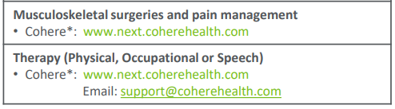
Cohere Overview
Notes:
Now, let’s take a look at Availity Portal tools.

Slide 103













Bringing the vision to life: Cohere patient journey
Today’s patient clinical journey is confusing and uncoordinated, resulting in poor patient experience and variation in outcomes.
By aligning stakeholders around optimal, longitudinal Care Paths, Cohere can steer care to appropriate sites and services which leads to high-value care.
ASC
Post-acute care
Orthopedist
Pharmacy
Hospital
PCP
PT/OT
Pharmacy
SNF
Patient
Patient
PCP
Imag
PT
Ortho
ASC
HH
Pain clinic
PT/OT
Imaging
Notes:
Duncan

Slide 104



Cohere is a digital prior authorization solution that offers:
One-stop-shop MSK prior authorizations that align with physician care plans
Faster prior authorization process resulting in fewer delays in care
Intuitive, modern software
Fewer, but more productive, peer-to-peers

Slide 105
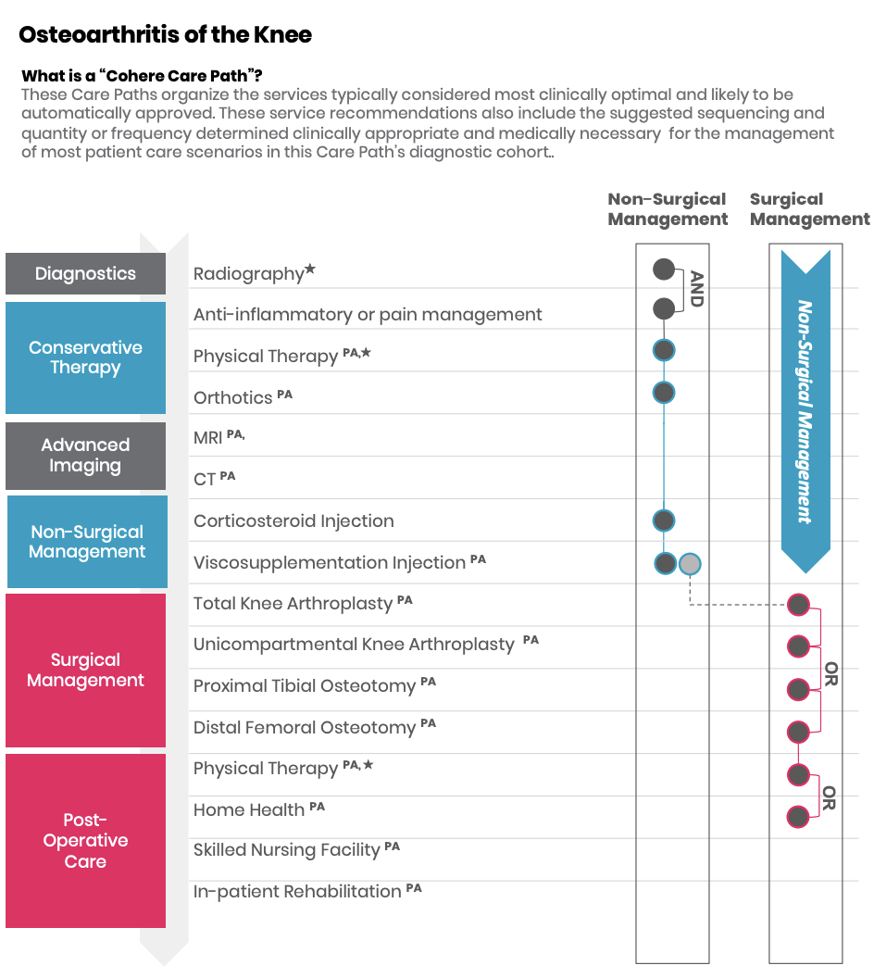


Cohere Difference: Organizing policies around how physicians practice
...in partnership with the American Academy of Orthopaedic Surgeons (AAOS)
Clinical Content Development
Registry & Quality Program
Medical Advisory Board
Thought Leadership

Slide 106
Networking
Break

Slide 107


Slide 108


Slide 109
Optum Care Network- Colorado
A local partner with national experience in value-based care
June 16, 2022

Slide 110

Optum Care Network – Colorado (OCNC) is a patient-centric, physician-led, data-driven, Independent Physician Association (IPA). We focus on cost-effective, high quality health outcomes for our members. We are a provider that is delegated for global risk for UHC Medicare Advantage.

Slide 111


Optum Care Colorado
Colorado Springs
Care Network - Colorado
Colorado Springs employed medical group¹
105+ providers across 8 locations
IPA focused on helping independent medical groups practice value-based care
Serving Denver, Colorado Springs, and the Front Range
Denver employed medical group
130+ providers across 20 locations

Slide 112



OCNC’s Value to PCP Practices
Clinical Resources
  Amplify the high-quality care you provide to your patients
Increased Financial Incentives
  Reinvest in yourself and your patients; base incentive and shared savings programs
Local, Dedicated Support
  Take care of your headaches and give you time back in your day

Slide 113

Wraparound Clinical Services for You and Your Patients
Quality Care Coordinator
OCNC Medical Director
Extension of your practice to help close the quality gaps in care for your patients
A clinical peer with a long history of success in value-based care who you can rely on for support
HCC Coding & Risk Management
Chronic Condition/ Disease Management Programs
Real-time insight into your patient’s chronic conditions; coding educators to help you know how to address them
An army of clinical and social resources to support you in caring for your sickest patients
Your local Network Manager coordinates services as a single point of contact

Slide 114
Partnering With Us

Slide 115
Medicare Advantage plans managed by Optum Care:
  H0609-007 AARP® Medicare Advantage SecureHorizons Plan 1
  H0609-012 AARP® Medicare Advantage SecureHorizons Plan 2
  H0609-018 AARP® Medicare Advantage Patriot
  H0609-034-001 AARP® Medicare Advantage SecureHorizons Plan 1
  H0609-034-002 AARP® Medicare Advantage SecureHorizons Plan 1
  H0609-036-001 AARP® Medicare Advantage SecureHorizons Plan 2
  H0609-036-002 AARP® Medicare Advantage SecureHorizons Plan 2
  H0609-041-000 AARP® Medicare Advantage Patriot
  H0609-048 AARP Medicare Advantage Plan 1 (HMO)
  H0609-804/806 UnitedHealthcare Group Medicare Advantage (HMO)
  H2577-001 AARP® Medicare Advantage Choice Plan 1 (PPO)
  H2577-002 AARP® Medicare Advantage Walgreens (PPO)
  H2577-003 AARP® Medicare Advantage Choice Plan 2 (PPO)
  H2577-022 AARP® Medicare Advantage Choice Plan 3 (PPO)
  H2577-023 AARP® Medicare Advantage Choice Plan 3 (PPO)

Slide 116
How to Identify Our Members
1
4
3
2
Payer ID: LIFE1
Network name
Provider services toll-free number
Medical claims address
Networks managed by Optum Care
• Optum Care Network North
• Optum Care Network South
• Optum Care Network Denver
• Optum Colorado Springs
• New West Physicians

Slide 117
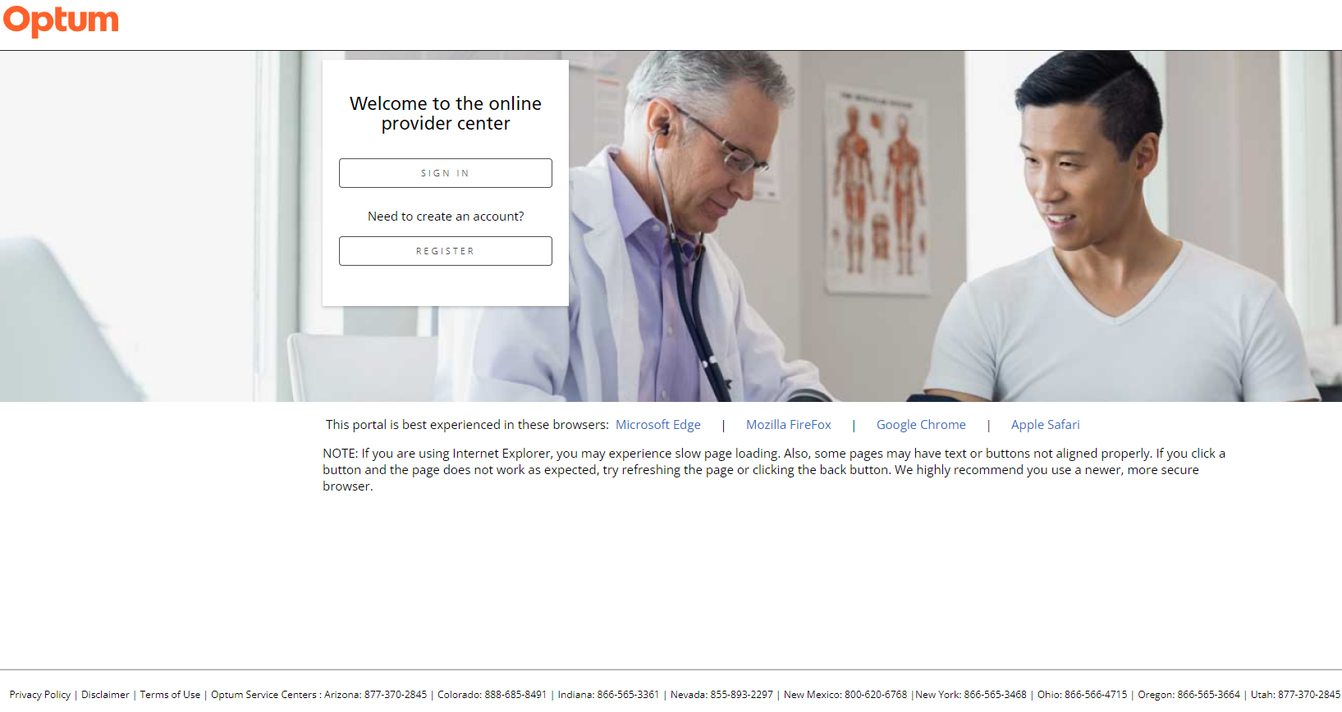
Where do you get help
Provider Services: 1-888-685-8491
Website: https://providers.optumcaremw.com
Claims dispute: claimdispute@optum.com
On the website you can:
Check eligibility
Review claims
Submit and review referrals and/or prior authorization

Slide 119


Slide 120
SonderMind
Jay Koren, MHA
Partnership Manager

Slide 121
Who we are
How we’re redesigning behavioral health

Slide 122
SonderMind is redesigning mental and behavioral health through improved access, utilization, and outcomes.
It’s never been more important to provide affordable and accessible mental health care.
We’re here to help you do it.
Confidential and Proprietary - SonderMind Inc © 2021

Slide 123

Meet Jay Koren, Partnership Manager
“Hello! My name is Jay and I am one of two Partnership Managers for SonderMind in Colorado. I have ten years of experience working in the healthcare industry. I started my career in healthcare recruitment before moving toward business development.
As an avid learner, I returned to school in 2020 and recently obtained my Masters in Healthcare Administration.
I joined SonderMind in February 2022 shortly after I started using them as a therapy provider myself. I love working for SonderMind because I am passionate about the work we do, and my therapy journey is proof of concept! It is truly remarkable to see when mental and behavioral health treatment is included in our daily practice how it can change our overall well-being for the better. I’m excited to work with partners in Colorado to improve the health of our community.”
Confidential and Proprietary - SonderMind Inc © 2021

Slide 124
SonderMind, Healthcare Systems, and Physician Groups
Comprehensive
Accessible
Effective
Your behavioral health partner of choice
Full-service
Multiple care models
Local and personalized care
Education and resources
Simple and seamless referral process
In network with most payors
Convenient patient experience
Proven clinical excellence
Outcomes-oriented
Measurement-based care
Notes:
Comprehensive:
Full-service outpatient solution
Medical behavioral integration options to support whole-person health
Local, specific, and personalized care
Accessible:
Simple and seamless referral process
Established payor relationships for affordable care
Patient convenience and ease of use
Effective:
Proven clinical excellence
Outcomes-focused
Established behavioral health provider relationships
Measurement-based care through clinical and functional questionnaires
Education and resources

Slide 125
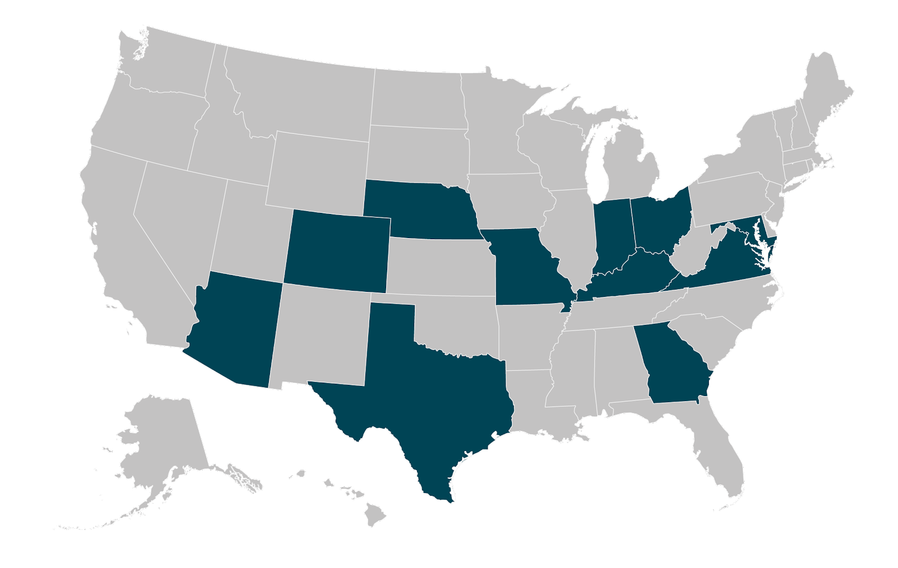
SonderMind’s reach
Currently operating in 12 states
3,600+ active, licensed providers nationwide
Data as of June 2022

Slide 126
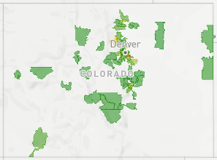
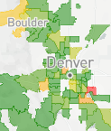
Comprehensive
Enabling access to quality providers and care in CO
SonderMind providers are available both in-person and remote to meet your patients’ needs
Geographic Coverage of SonderMind Providers
SonderMind Colorado Provider Network
1,500
Active, licensed providers
655
In-person providers
Data as of June 2022
Confidential and Proprietary - SonderMind Inc © 2022

Slide 127
Comprehensive
Supporting the Medicare population in CO
SonderMind is in-network with Medicare FFS and many Medicare Advantage plans
829 active providers who treat individuals age 65+
To enable our providers to successfully treat clients in this age group, we provide geropsychology resources such as guidelines, trainings, and Medicare regulation resources.
Data as of June 2022
Notes:
“Baby boomers seeking mental-health care are getting an unpleasant surprise when they turn 65: Finding a therapist who takes Medicare can be harder than finding one who takes private insurance.” – Wall Street Journal

Slide 128
Comprehensive
Supporting the child & adolescent population in CO
108 active providers who treat individuals ages 0-5
226 active providers who treat individuals ages 6-12
647 active providers who treat individuals ages 13-17
To enable our providers to successfully treat clients in this age group, we offer educational opportunities like child and adolescent specialty case consultations led by industry experts, as well as CE webinars.
Data as of June 2022

Slide 129
Comprehensive
Supporting the perinatal population in CO
To enable our providers to be successful in treating this population, we offer training for perinatal care, a library of educational content, and regular peer-to-peer case consultations.
247 active providers who specialize in perinatal support
Data as of June 2022

Slide 130
Comprehensive
Psychiatry availability in CO
27 active psychiatrists and psychiatric nurse practitioners in Colorado. 14 are accepting new patients and are available for psychiatric evaluation, medication management, and ongoing psychiatric care.
To enable our psychiatric providers to be successful, we offer bi-weekly coaching and collaborative sessions.
Data as of June 2022

Slide 131
Accessible
Reducing the wait time to connect clients with a licensed therapist
3 hrs
5-10 vs. 25
Average time to match with a SM therapist
Days to first therapy session vs. national average
Notes:
Delays to care can cause clients to lose the courage that drove them to seek care.
Long wait times are tied to adverse outcomes, including increased duration of treatment, unnecessary hospitalization, and a higher risk of suicide.

Slide 132











Accessible
Making therapy affordable to more of the population - Colorado
*
*Coverage is subject to a beneficiary's specific health plan.
Notes:
Colorado

Slide 133
Effective
Demonstrating clinical efficacy
Our data shows that clients with a clinical diagnosis of moderate to severe
depression or mild to severe anxiety see results in less than 6 sessions — that's less than 2 months — on the SonderMind platform.
49.4 days
57.2 days
For clients with a clinical diagnosis of moderate to severe depression, it takes on average 49.4 days (or
5.5 sessions) to progress from a clinical to subclinical diagnosis.
For patients with a clinical diagnosis of mild to severe anxiety, it takes on average
57.2 days (or 5.9 sessions) to progress from a clinical to subclinical diagnosis.

Slide 134
How we work
Joining the SonderMind network

Slide 135



Getting started with SonderMind
Discuss
Refer
We’ll take care of the rest
Key steps for an in-network referral
Have mental health conversations with your patients. Identify your patient’s presenting concerns. We provide tools to help you along the way.
Easily refer your patients to SonderMind via fax, email, or phone by visiting: sondermind.com/refer
We’ll need your patient’s first name, email, insurance information, and what their presenting concerns are.
SonderMind care coordinators will ensure your patient is connected to a licensed therapist or psychiatrist within 48 hours, selected to meet your patient’s unique needs.

Slide 136





SonderMind Client Journey
Patient has first appointment and, with their therapist, builds a treatment plan for their unique needs
PCP or Medical Practice makes a request via sondermind.com/refer.
Patient will set up and complete their account
SonderMind care coordinator reaches out to patient
Patient will match with a therapist and schedule their appointment
Confidential and Proprietary – SonderMind Inc. © 2020
Notes:
PCP or Medical Practice makes a request via sondermind.com/refer.
SonderMind care coordinator reaches out to the patient via text, email, and/or phone.
Patient will set up their profile and complete their account.
The patient’s selected provider will reach out to the patient directly using the chat function, phone, or email. Or, the patient can reach out to the provider.
Patient can schedule an appointment with direct scheduling or by speaking with the provider.
Patient will be asked to complete clinical questionnaires about their unique needs in preparation for therapy.
Patient has their first therapy session in-person, or virtually using the SonderMind platform.
Patient will be charged applicable copays/deductibles, while SonderMind takes care of the insurance billing. The patient can see billing history in the SonderMind portal.
Patient and therapist work together to develop a tailored treatment plan to meet the patient’s unique goals.

Slide 137
Integrated Therapist
Select a SonderMind therapist to work specifically with your practice. An Integrated Therapist acts as an extension of your care team, providing mental health care services for your patients, either on-site or through SonderMinds Video Telehealth™ platform.
Notes:
Key features:
We’ll match your practice to a SonderMind therapist best suited to meet your patients’ needs.
You will have a therapist dedicated to your practice and patients that will feel like an extension of your practice. That therapist will be available for only your patients during certain time periods throughout the week – either on-site or via video.
Rest assured that your patients will have access to the right therapist within the SonderMind network for their needs, even if it’s not the integrated therapist aligned to your practice.
Benefits:
Build a collaborative relationship directly with your integrated therapist – increasing your practice’s ability to provide whole-person care to patients.
Patients from practices with an integrated therapist are more likely to follow through on seeing a therapist and more likely to continue therapy.

Slide 138
Collaborative Care Model (CoCM)
Work with a Behavioral Health Care Manager and a consulting psychiatrist to deliver a patient-centered, population health approach to behavioral health in your primary care practice. With CoCM, your practice can seamlessly transition patients requiring in-depth and ongoing mental health care to a SonderMind therapist.
Notes:
Key features:
We’ll match your practice to a SonderMind Behavioral Health Care Manager and consulting psychiatrist to fully integrate behavioral health into your practice.
The Behavioral Health Care Manager will triage patients, maintain the CoCM registry, conduct brief interventions, and run the weekly case consultations with the consulting psychiatrist.
If you have a patient that needs ongoing therapy, you still have access to the full SonderMind provider network.
Benefits:
A time-efficient way to provide integrated behavioral health in a primary care setting
Additional revenue opportunity for your practice
Professional development for practice staff via consultation with the psychiatrist

Slide 139
Questions?

Slide 140
Closing Remarks
CMGMA Fall Conference
September 14-16, 2022
Embassy Suites, Loveland
Emerging Professionals Quarterly Socials
CMGMA Membership

